Slide 1
Uniform Solution Sampling Using a Constraint Solver As an Oracle
Stefano Ermon
Cornell University
August 16, 2012
Joint work with Carla P. Gomes and Bart Selman

Slide 2
Motivation: significant progress in combinatorial reasoning
SAT/MIP:
From 100 variables, 200 constraints (early 90’s) to over
1,000,000 variables and 5,000,000 constraints in 20 years.
Applications:
hardware and software verification (bounded model checking),
planning, scheduling, protocol design, routing, supply-chain
optimization, e-commerce (e-auctions and electronic trading agents)
technical advances: automated constraint inference, dynamic variable ordering, randomization, etc.
SAT: Given a Boolean formula Φ in CNF, Φ=C₁ΛC₂ Λ…ΛC_{m}, does Φ have a satisfying assignment?
Can we apply these techniques to boost probabilistic reasoning?

Slide 3
Beyond SAT: solution sampling
Probabilistic reasoning and graphical model inference tasks can be mapped into equivalent problems for weighted SAT formulas:
Sampling for Weighted SAT:
clauses (constraints) with weights Φ=(C₁,w₁)Λ(C₂,w₂) Λ…Λ(C_{m},w_{m})
truth assignments sampled in proportion to the exponential of the negated sum of weights of violated constraints. Logic + Probability (Markov Logic)
X₁∈{0,1}
X₂∈{0,1}
Formula over X₁,X₂,X₃,X₄:
…..
X₂ V X₄ , -a₁
¬ X₂ V X₄ , -a₂
X₂ V ¬ X₄ , -a₃
¬X₂ V¬ X₄ , -a₄
…..
Potential ϕ₂₄(X₂,X₄):
 | ₀ | ₁
₀ | a₁ | a₂
₁ | a₃ | a₄
MRF
violated when both X₂ and X₄ are 0
X₃∈{0,1}
X₄∈{0,1}
P(X) ~ exp(∑ϕ_{c}(X_{C}))
P(X) ~ exp(-∑ w_{i} χ_{i}(X_{i}))
Clique C
Clause i

Slide 4
Beyond SAT: solution sampling
First step: uniform solution sampling
infinite weights case: probability zero when a constraint is violated
equivalent to sampling from a uniform probability distribution Q over the set of solutions of a formula F
useful for the weighted case (MC-SAT [Poon & Domingos, 2006]):
idea: solve unweighted problems on a subset of constraints selected according to their weights
still computationally hard:
decide if support of Q is empty or not is NP-complete (SAT)
sampling is believed to be harder (#P-complete)
still very difficult for MCMC techniques
Weighted
Sampler
Uniform
Sampler
Constraint Solver

Slide 5
Why sampling is hard?
Variable 1
Naïve Rejection Sampling:
randomly select paths in the tree
if the leaf (complete assignment) is a solution, output it.
extremely inefficient if there are only few solutions.
Variable 2
Variable n
✗
✗
✓
= a solution

Slide 6
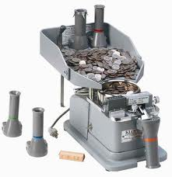
Sampling with an Oracle
?
5
Variable 1
Counting Oracle:
How many solutions in the subtree rooted at a certain node?
Variable 2
?
0
Variable n

Slide 7
Sampling with an Oracle
Variable 1
Counting Oracle:
How many solutions in the subtree rooted at a certain node?
uniform sampling
no rejections
but counting is hard (#P-Complete)
Variable 2
X_{k}=0
X_{k}=1
2
?
?
3
Variable n
2/5
1/5
marginals
3/5

Slide 8

Sampling with a SAT Oracle
?
YES
Variable 1
Satisfiability Oracle:
Is there at least a solution in the subtree rooted at a certain node?
computationally “easier” (NP-complete)
mature technology
Can we use this to sample?
Variable 2
?
NO
Variable n

Slide 9

Sampling with a SAT Oracle
Variable 1
Satisfiability Oracle:
Is there at least a solution in the subtree rooted at a certain node?
Variable 2
X_{k}=0
X_{k}=1
NO
?
?
YES
Variable n
We know how to pick the marginals
0
1

Slide 10
Sampling with a SAT Oracle
Variable 1
Satisfiability Oracle:
Is there at least a solution in the subtree rooted at a certain node?
Variable 2
X_{k}=0
X_{k}=1
YES
?
?
YES
Variable n
How to pick the marginals in this case?
???
???

Slide 11
Uniform Marginals
X_{k}=0
X_{k}=1
YES
?
?
YES
empty assignment
F = X₁ V X₂
0.5
0.5
0.5
0.5
Suppose we pick 0.5 / 0.5 as we did for rejection sampling.
X₁=0
X₁=1
It is NOT uniform!
Sample anyways and correct for it
in sample averages.
0
1
0.5
0.5
X₂=0
X₂=1
P = 0.5
P = 0.25
P = 0.25
Knuth [1975], Jerrum et al. [1986], Gomes et. al [2006], Gogate et. al [2007,2011], Kroc et. al [2008]

Slide 12
A Challenging Example
has to guess 40 variables correctly in order to reach the other 2⁶⁰ solutions
100 variables
gets here with probability 2⁻⁴⁰
Needs on average 2⁴⁰ samples before reaching the big cluster
…
…
40 isolated solutions
“Small” importance
2⁶⁰ solutions
“Large” importance

Slide 13
SearchTreeSampler: a recursive approach
Definitions:
variable ordering (X₁, …, X_{n})
pseudosolution at level i
= assignment to first i variables that can be extended to form a solution
constraint solver can tell us this (YES/NO answer)
level i
pseudosolutions of level n are the solutions
= cannot be extended to form a solution
= can be extended to form a solution

Slide 14
SearchTreeSampler: a recursive approach
Recursive idea:
Suppose we have a way to sample pseudosolutions of level n-1
Can we sample pseudosolutions of level n (= solutions)?
pseudosolutions of level n are the solutions
sample one (uniformly)
S = descendants that can be extended to a solution (SAT solver)
sample one from S and output
not uniform (some solutions are sampled twice as often)
level n-1
S
= cannot be extended to form a solution
= can be extended to form a solution

Slide 15
SearchTreeSampler: a recursive approach
Recursive idea:
Suppose we have a way to sample pseudosolutions of level n-1
Can we sample pseudosolutions of level n (= solutions)?
pseudosolutions of level n are the solutions
sample all pseudosolutions of level n-1
S = union of descendants that can be extended to a solution (SAT solver)
sample one from S and output
perfectly uniform, but still inefficient (S might be too big)
level n-1
S
= cannot be extended to form a solution
= can be extended to form a solution

Slide 16
SearchTreeSampler: a recursive approach
Recursive idea:
Suppose we have a way to sample pseudosolutions of level n-1
Can we sample pseudosolutions of level n (= solutions)?
pseudosolutions of level n are the solutions
sample k pseudosolutions of level n-1
S = union of descendants that can be extended to a solution (SAT solver)
sample one from S and output
approximately uniform:
k/(k+1) ≤ P(s) / P(s’) ≤ (k+1)/k
sampling from S ≈ sampling from the solution set
k=2
level n-1
How to sample pseudosolutions of level n-1?
S

Slide 17
SearchTreeSampler: a recursive approach
Recursive idea:
Suppose we have a way to sample pseudosolutions of level n-2
Can we sample pseudosolutions of level n-1?
sample k pseudosolutions of level n-2
S = descendants that can be extended to a solution (SAT solver)
sample from S and output
previous bound on the uniformity still holds
sampling from S ≈ sampling from the pseudosolution set of level n-1
level n-2
level n-1
S

Slide 18
SearchTreeSampler Demo
Input: k (=2)
0. variable ordering
1. root = empty assignment
2. check SAT
3. generate descendants
check F Λ (X₁=0)
check F Λ (X₁=1)
4. sample up to k from level 1
5. generate descendants
6. sample up to k from level 2
7. generate descendants
…
sample up to k from level n-1
generate descendants (solutions)
level 0
at most 2 samples per level
level 1
need fast SAT solver!
n-1
= cannot be extended to form a solution
= can be extended to form a solution
Notes:
Need more details here

Slide 19
Complexity
generate descendants at the lower level using the SAT solver
Search tree can be divided into less than n levels
uniformity bound: k/(2^{L}+k-1) ≤ P(s) / P(s’) ≤ (2^{L}+k-1)/k
Parameterized scheme:
levels height L
max samples per level k
Performance
requires O((n/L)*2^{L}*k) calls to a SAT solver to generate k samples
k ↑ increases uniformity, L↑ reduces the number of recursions
L
(L=1,k=1) ↔ uniform marginals
(L=n) ↔ 1 level ↔ enumeration (uniform)
L,k
increased complexity ↑
increased uniformity ↑
What happens for intermediate values of k and L?

Slide 20


Challenging Domains
Golf-course landscape:
Energy barriers:
E = 1
Energy = # violated constraints
E = 0
solutions
h
Energy = # violated constraints
asymmetric space

Slide 21
Challenging Domains
Random + Energy barriers
only SearchTreeSample provides uniform samples

Slide 22
Challenging Domains
Asymmetric spaces + Energy barriers
clusters of solutions of different sizes on the sides
h
E
SampleSAT oversamples this solution

Slide 23
Challenging Domains
Probability of observing an event at least as extreme
Method | Instance | Parameter | Time(s) | P-value
SA | logistic | T=0.25 | 11028 | 0.11
SampleSAT | logistic | - | 7598 | 0.23
SearchTreeSampler | logistic | k=5 | 9.8 | 0.14
SearchTreeSampler | logistic | k=20 | 10.1 | 0.77
SearchTreeSampler | logistic | k=50 | 9.6 | 0.99
SA | logistic+Barrier | T=0.25 | 42845 | 0
SampleSAT | logistic+Barrier | - | 7296 | 0
SearchTreeSampler | logistic+Barrier | k=20 | 42.53 | 0.9
>2 orders of magnitude faster
NOT affected by barriers

Slide 24
Challenging Domains
Method | Instance | Parameter | Time(s) | P-value
SA | coloring | T=0.25 | 7589 | 0.71
SampleSAT | coloring | - | 28998 | 0
SearchTreeSampler | coloring | k=50 | 184 | 0.9
SearchTreeSampler | coloring | k=100 | 204 | 0.98
SearchTreeSampler | coloring | k=200 | 228 | 1
SA | coloring+Barrier | T=0.25 | 29434 | 0
SampleSAT | coloring+Barrier | - | 29062 | 0
SearchTreeSampler | coloring+Barrier | k=100 | 435 | 0.99
>2 orders of magnitude faster
NOT affected by barriers

Slide 25
Challenging Domains
Method | Instance | Parameter | Time(s) | P-value
SA | random | T=0.3 | 8673 | 0.88
SampleSAT | random | - | 740 | 0
SearchTreeSampler | random | k=10 | 2.5 | 0
SearchTreeSampler | random | k=15 | 3 | 0.96
SearchTreeSampler | random | k=20 | 5 | 0.98
SA | random+Barrier | T=0.3 | 71077 | 0
SampleSAT | random+Barrier | - | 744 | 0
SearchTreeSampler | random+Barrier | k=20 | 7.1 | 0.95
>2 orders of magnitude faster
NOT affected by barriers
What happens if # solutions >> k?

Slide 26
Model Counting
How to evaluate uniformity when the solution set of F is very large (e.g., 10²⁰)?
cannot estimate the empirical distribution
cannot validate the sampling quality directly (e.g., via Pearson’s chi-squared test)
Model counting:
Let S_{F} be the set of solutions of F.
Indirect validation: use samples to estimate |S_{F}|. Better samples should provide more accurate counts.
New model counting technique:
intermediate samples of SearchTreeSampler provide us with additional information about the model count

Slide 27
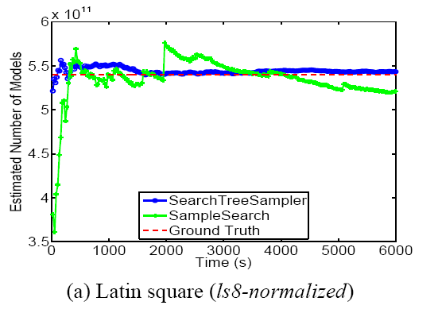
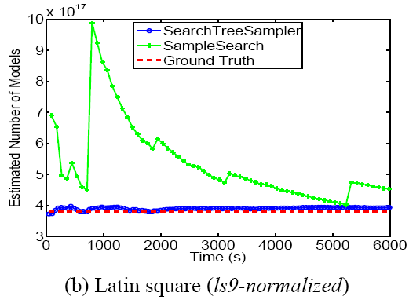
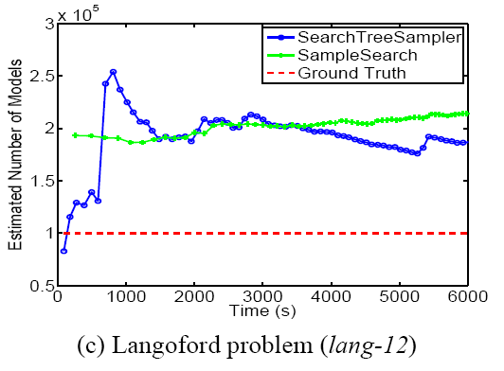
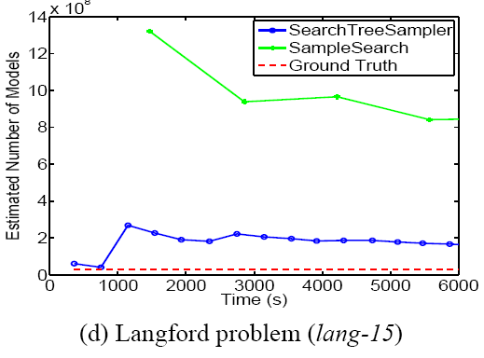
Experimental Results
x 10¹¹
x 10¹⁷
x 10⁵
x 10⁸

Slide 28
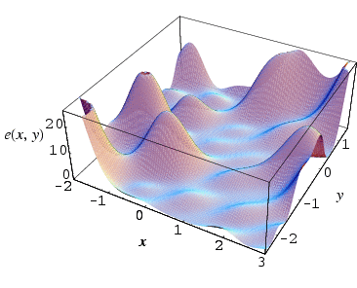
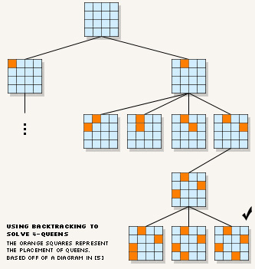
The Big Picture
Combinatorial Reasoning
Probabilistic Inference
local search
MCMC sampling
Gibbs Sampling
Simulated Annealing
faster in industrial applications
Combinatorial
Search
Conditioning
on
variables
backtrack
search (YES/NO)
No clear analogous
XORSampling [2006]
SampleSearch [2007]
SearchTreeSampler
key component
Constraint Propagation
Message-Passing / Variational
Belief Propagation (BP)
Variable elimination
Junction Tree

Slide 29
Conclusions
Combinatorial reasoning techniques for probabilistic reasoning
New technique for solution sampling
Samples the search tree level by level
leverages state-of-the-art SAT-solver as a black-box
parameterized scheme: trade-off between computational cost and uniformity of the samples
Demonstrated performance on challenging domains for MCMC methods
significantly faster
more uniform (Pearson’s Test)
New model counting technique:
vertical vs. horizontal division of the search tree
intermediate samples provide information about the model count

Slide 30

Thank YOU!

