Slide 1
Learning Policies For Battery Usage Optimization in Electric Vehicles
Stefano Ermon
ECML-PKDD
September 2012
Joint work with Yexiang Xue, Carla Gomes, and Bart Selman
Department of Computer Science, Cornell University

Slide 2
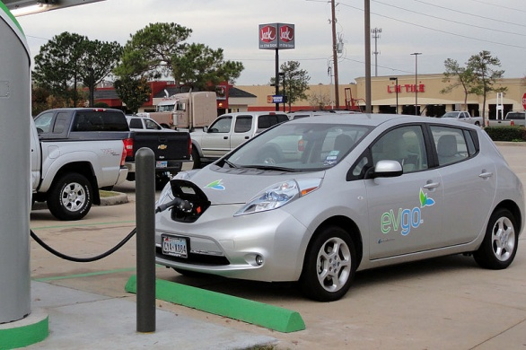
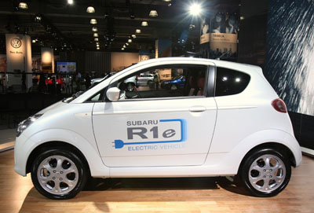
Introduction
In 2010, transportation contributed approximately 27 percent of total U.S. greenhouse gas emissions
accounts for 45 percent of the net increase in total U.S. greenhouse gas emissions from 1990-2010 [U.S Environmental Protection Agency, 2012]
More sustainable transportation:
low-carbon fuels
strategies to reduce the number of vehicle miles traveled
new and improved vehicle technologies
operating vehicles more efficiently
Nissan CEO has predicted that one in 10 cars will run on battery power alone by 2020.
The U.S. has pledged US$2.4 billion in grants for electric cars and batteries.
Our Work : Machine Learning and AI to make this technology more practical

Slide 3
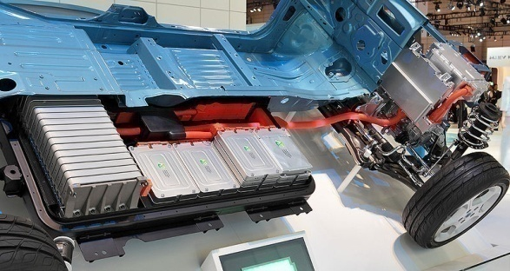
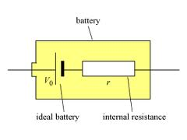
Introduction
Major limitations in battery technology:
Limited capacity (range)
Price
Limited lifespan (max number of charge/discharge cycles)
Inefficient (energetically) for vehicle usage
Internal resistance:
Peukert's Law: the faster a battery is discharged with respect to the nominal rate, the smaller the actual delivered capacity is (exponential in the current I)
Energy wasted as heat:
r . I²

Slide 4
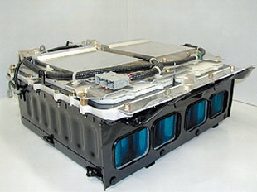
Multiple-battery systems
Both effects depend on variability of the output current:
How can we keep output more stable? Cannot control demand..
Multiple-battery systems [Dille et al. 2010, Kotz et al 2001,…]:
Include a smaller capacity but more efficient battery
Hope: get the best of both worlds
Large capacity
High efficiency
Reasonable cost
Wastes more energy (variance)
Same total energy output (integral)
current
current
time
time

Slide 5
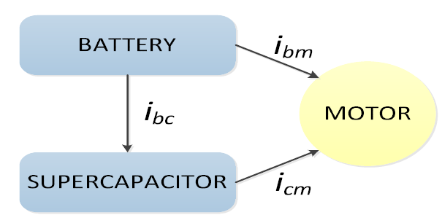
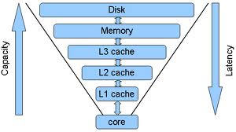
Multiple-battery systems
Use a supercapacitor that behaves like an ideal battery
Intuition:
battery is good at holding the charge for long times
supercapacitor is efficient for rapid cycles of charge and discharge
Use supercapacitor as a buffer to keep battery output stable
Store when demand is low, then discharge when demand is high
Smaller (1000 times)
More expensive
More efficient
Notes:
50 watt – hour capacitor, 50 000 watt hour battery
Nissan leaf 24 000 watt hour
Tesla 54 000 watt hour

Slide 6
Multiple-battery Management
Performance depends critically on how the system is managed
Difficult problem:
Vehicle acceleration (-)
Regenerative braking (+)
Highly stochastic
Example policy: “keep capacitor close to full capacity”
ready for sudden accelerations ✓
suboptimal because there might not be enough space left to hold regenerative braking energy ✗
Intuitively, the system needs to be able to predict future high-current events (positive or negative), preparing the capacitor to handle them
Charge level

Slide 7
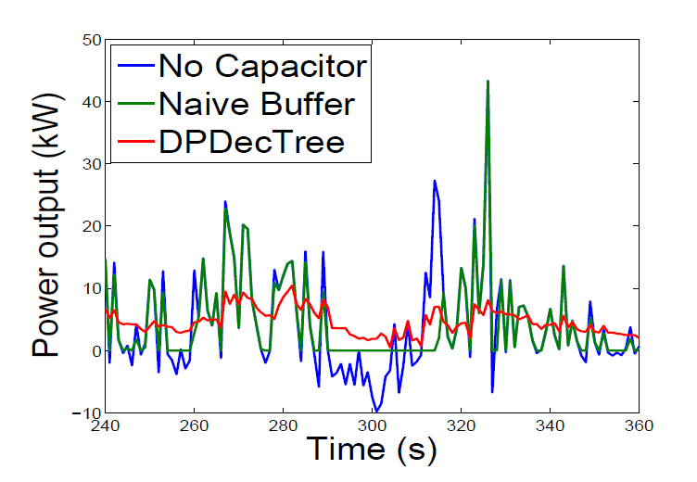
Objective
Goal: design an Intelligent Management System
Past driving behavior
Intelligent
Management System
Action: how to allocate the demand
Vehicle conditions
How much energy from battery?
How much energy from capacitor?
Should we charge/discharge the capacitor?
Position, speed, time of the day, …
Mining a large dataset of crowdsouced commuter trips, we constructed DPDecTree
Can keep battery output stable
(less energy is wasted)
(Real world trip, based on vehicle simulator)

Slide 8
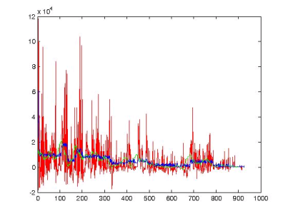
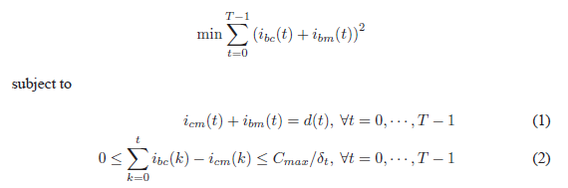
Modeling
Current from battery to motor
Demand d
Quadratic Programming formulation over T steps:
(1): demand has to be met
(2): cannot overcharge/overdraw the capacitor
I²-score: sum of the squared battery output
subject to
QP (CVXOPT) can only solve relatively short trips (no real-time planning)

Slide 9
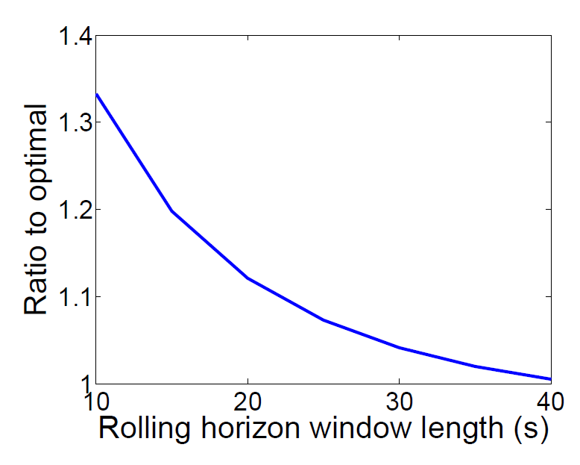
Speeding up
Reduce the dimensionality (change of variables):
3T → T variables
Exploit the sequential nature of the problem: discretized problem can be solved by dynamic programming
Faster than CVXOPT (~2 orders of magnitude)
Suboptimal (discretized) but close
What if we only partially know the future demand?
Rolling horizon:
Example: QP score of 3.070 in about 11 minutes. DP solver: score of 3.103 in 15 seconds.
Knowing the future 10 seconds is enough to be within 35% of omniscent optimal
Demand is stochastic (unkown)
Can we construct a probabilistic model?

Slide 10
MDP Modeling
We formulate as an MDP:
States = (charge levels, current demand, GPS coordinates, speed, acceleration, altitude, time of day, …)
Admissible Actions= (i_{bm},i_{bc},i_{cm}) that meet the demand
Cost= i² score, (i_{bm} + i_{bc})² squared battery output current
Transition probabilities?
we have an internal model for the batteries
We need a model for vehicle dynamics + driving behavior
Assumed to be independent
i(t)
o(t)
C
C(t+1)=C(t) +i(t) -o(t)
We leverage a large crowd-sourced dataset of commuter trips (ChargeCar project) to learn the model

Slide 11
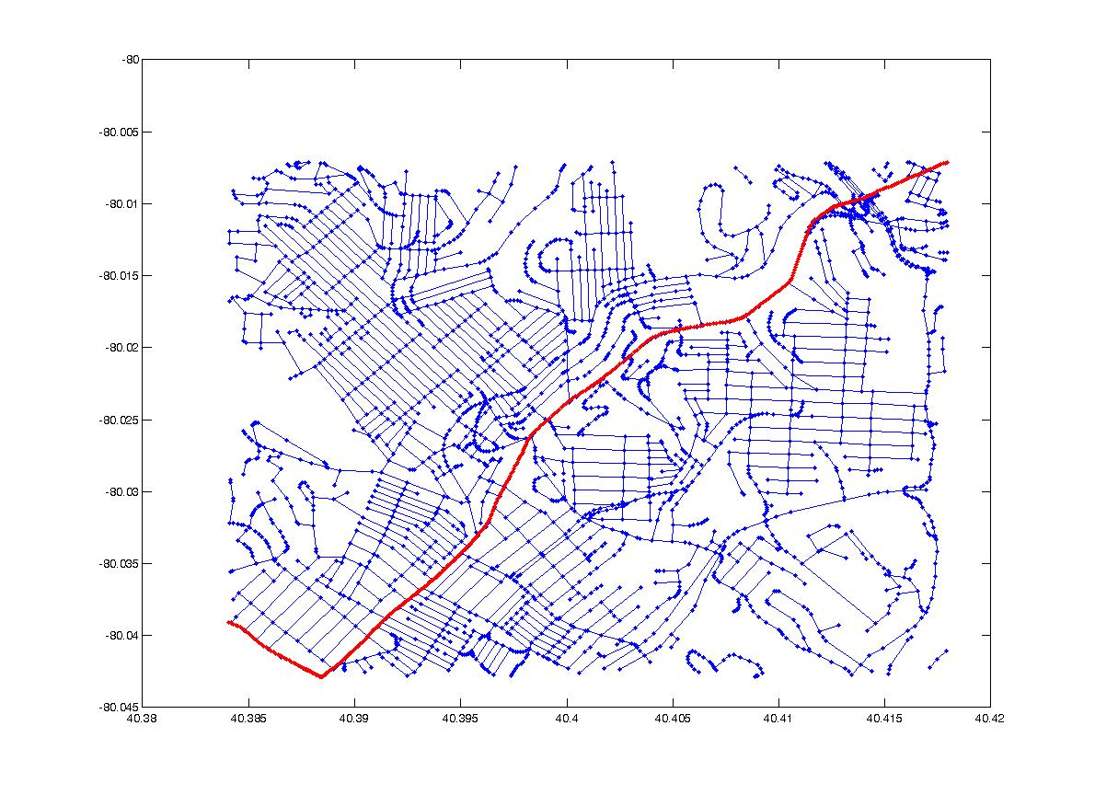
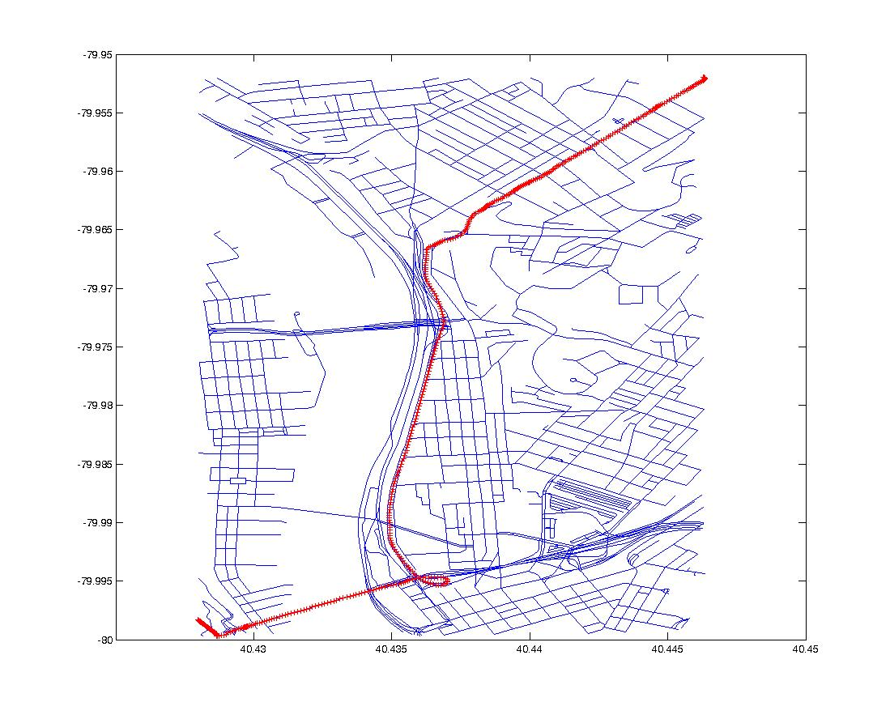
Available Data
ChargeCar Project (www.chargecar.org)
Crowdsourced dataset of commuter trips across United States
Publicly available

Slide 12
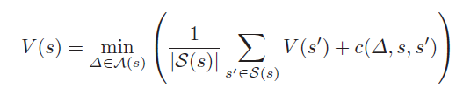
Sample based optimization
Compute “posterior-optimal” action for every observed state s
Trip 1
A trip is a sequence of states
Given a state s, what’s the best action to take?
Trip 2
s
Trip 3
S(s)
MultiSet of all possible successors that have been observed
Equivalent to learnining the transition probabilities and optimize the resulting MDP

Slide 13
Training set generation
Generate training set of (state, action) pairs
Generate more examples by looking at other (hypothetical) charge levels per state (models are decoupled)
Then use supervised learning to learn a policy (regression)
Policy: mapping from states to actions
Compact
Generalizes to previously unseen states
Crowd-souced Trips
(State,Action)
(State,Action)
…
(State,Action)
Policy
Sample based
optimization
Supervised Learning
(regression)

Slide 14
Learning the policy
ChargeCar algorithmic competition
Dataset: 1,984 trips (average length 15 minutes)
Training set: labeled pairs (state, optimal action)
Judging set: 168 trips (8%)
We use Bagged Decision Trees
Split according to capacity when training set is too big.
The resulting policy is called DPDecTree

Slide 15
Results
Using DPDecTree, the battery output is significantly smoother
→ energy savings
Notes:
The Volt concept car became the first application of the E-Flex (Voltec) drive system with a combination of an electric motor, the same used in the Chevrolet Equinox Fuel Cell, a 16 kWh (58 MJ) lithium-ionbattery pack with 136 kW of peak power, and a genset consisting of a small 1.0 L, 3-cylinder turbocharged flex-fuel capable engine linked to a 53 kW (71 hp) generator. General Motors called this genset an electric vehicle (EV) range extender. The vehicle was propelled by an electric motor with a peak output of 120 kW (160 hp) delivering 236 lb-ft (320 N-m) of motoring torque. The concept car featured several advanced materials from GE Automotive Plastics which allowed GM to reduce the vehicle weight up to 50 percent.

Slide 16
ChargeCar competition results
Score = sum of squared battery output. Lower is better.
Dataset | DPDecTree | MPL | Naïve Buffer | Baseline | Omniscent
alik | 4.233 | 4.435 | 7.533 | 8.424 | 3.196
arnold | 4.090 | 3.946 | 8.402 | 8.894 | 3.332
mike | 3.245 | 3.290 | 4.874 | 5.128 | 3.083
thor | 1.648 | 1.787 | 3.931 | 4.596 | 1.413
illah | 0.333 | 0.353 | 0.751 | 0.856 | 0.211
gary | 2.000 | 2.146 | 5.187 | 5.857 | 1.261
Total | 15.549 | 15.957 | 30.678 | 33.755 | 12.496
2.5% improvement, statistically significant
(one-sided paired t-test and Wilcoxon Signed Rank test)

Slide 17
Conclusions
Electric vehicles as a promising direction towards more sustainable transportation systems
Battery technology is not mature
Multiple-battery systems as a more cost-effective alternative
AI/Machine learning techniques to improve performance:
QP formulation for the battery optimization problem
Use of sample-based optimization + supervised learning
Outperforms other methods in the ChargeCar competition
Growing interest in mining GPS trajectories (Urban Computing)
Many datasets publicly available
Our angle: focused on energy aspects (Computational Sustainability)
Many other applications

