Slide 1


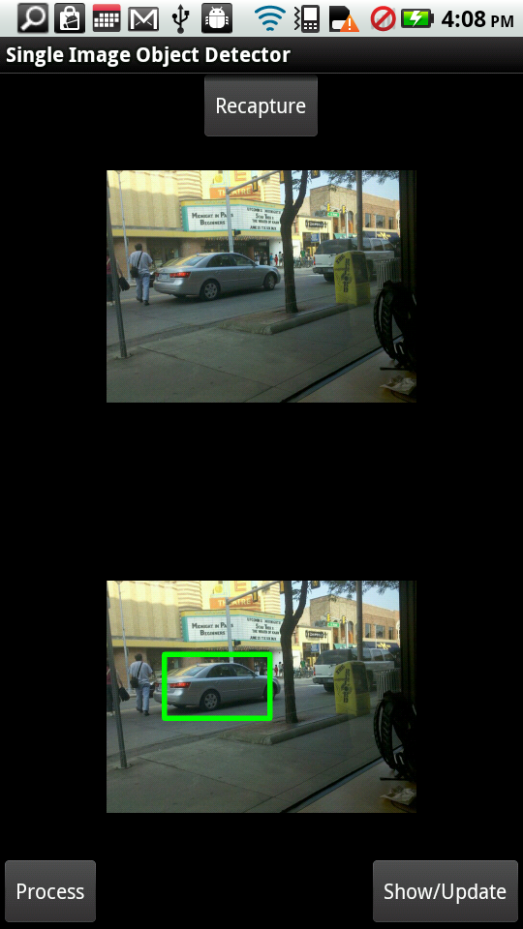
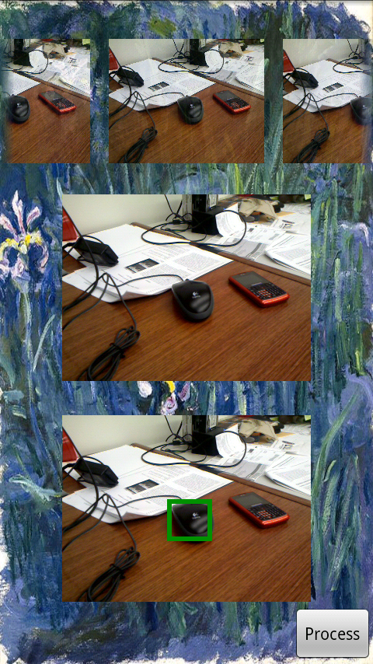
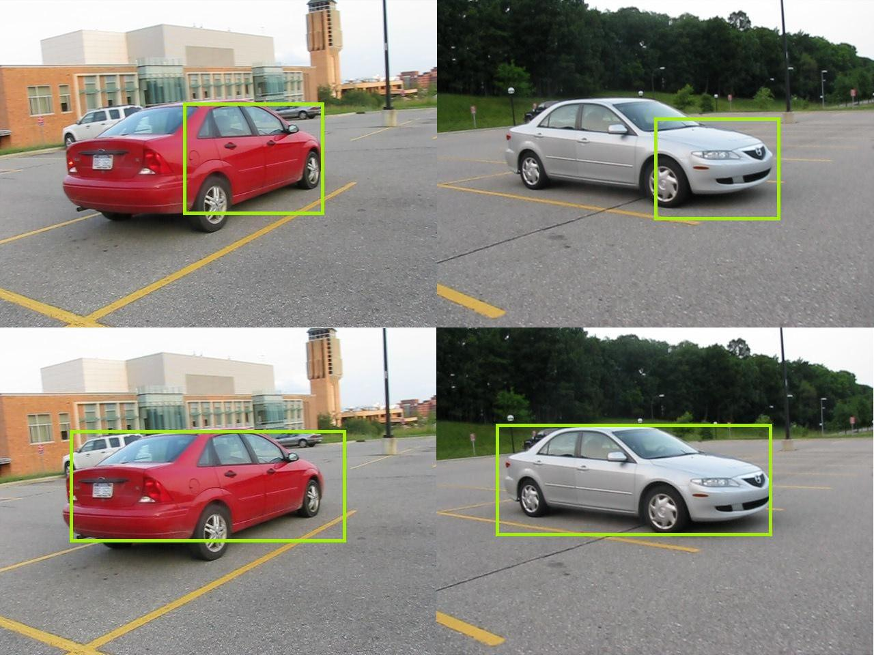
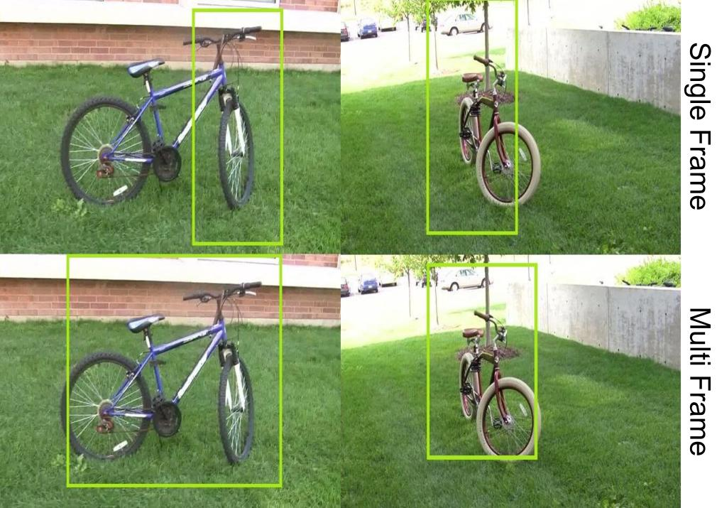
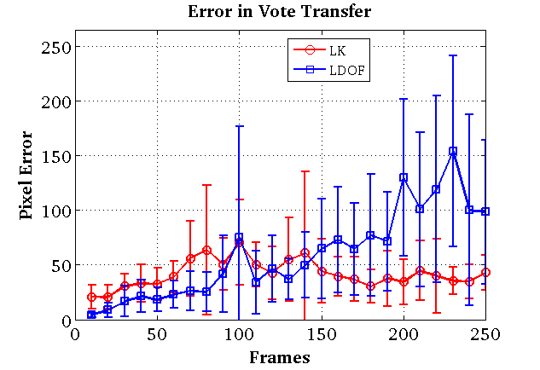
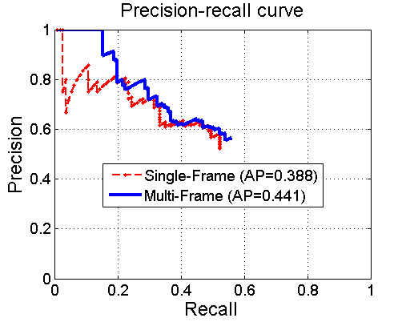
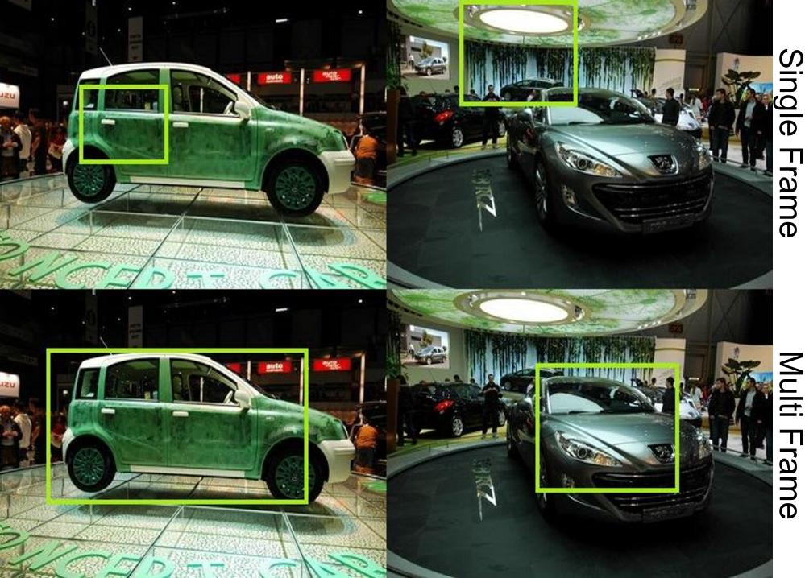
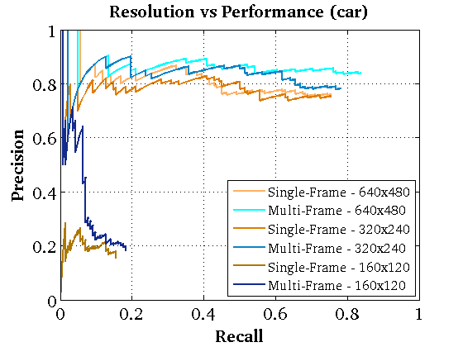
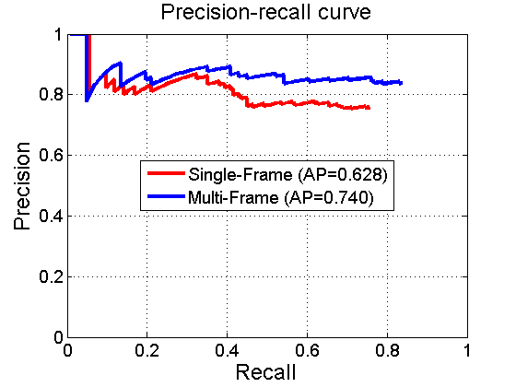
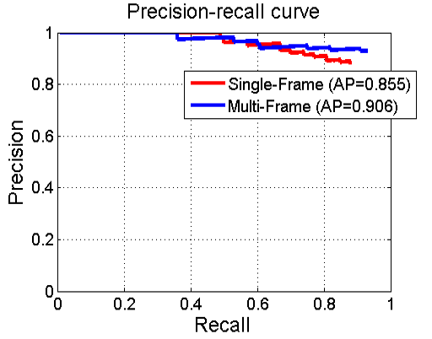
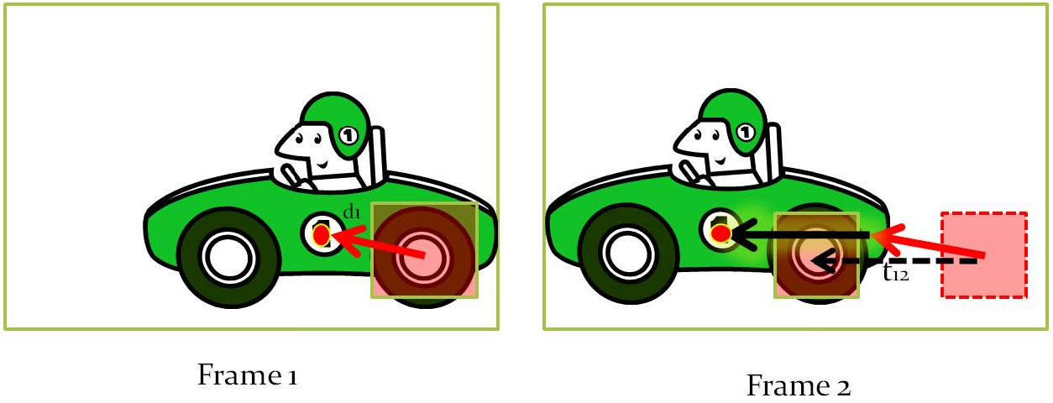
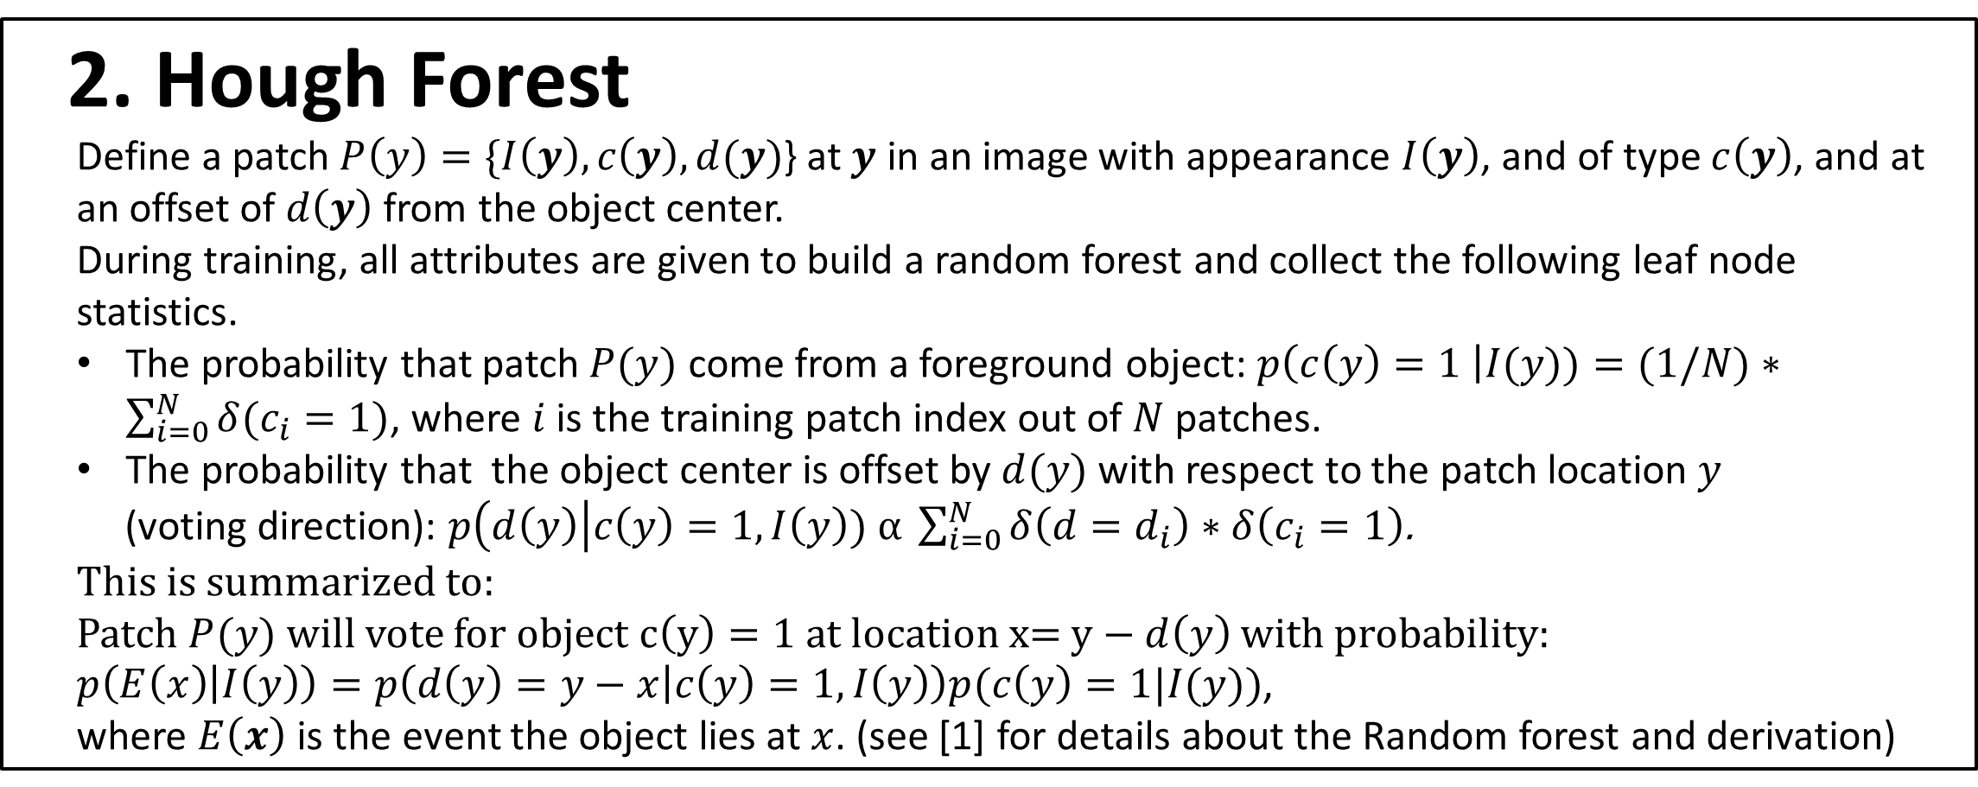
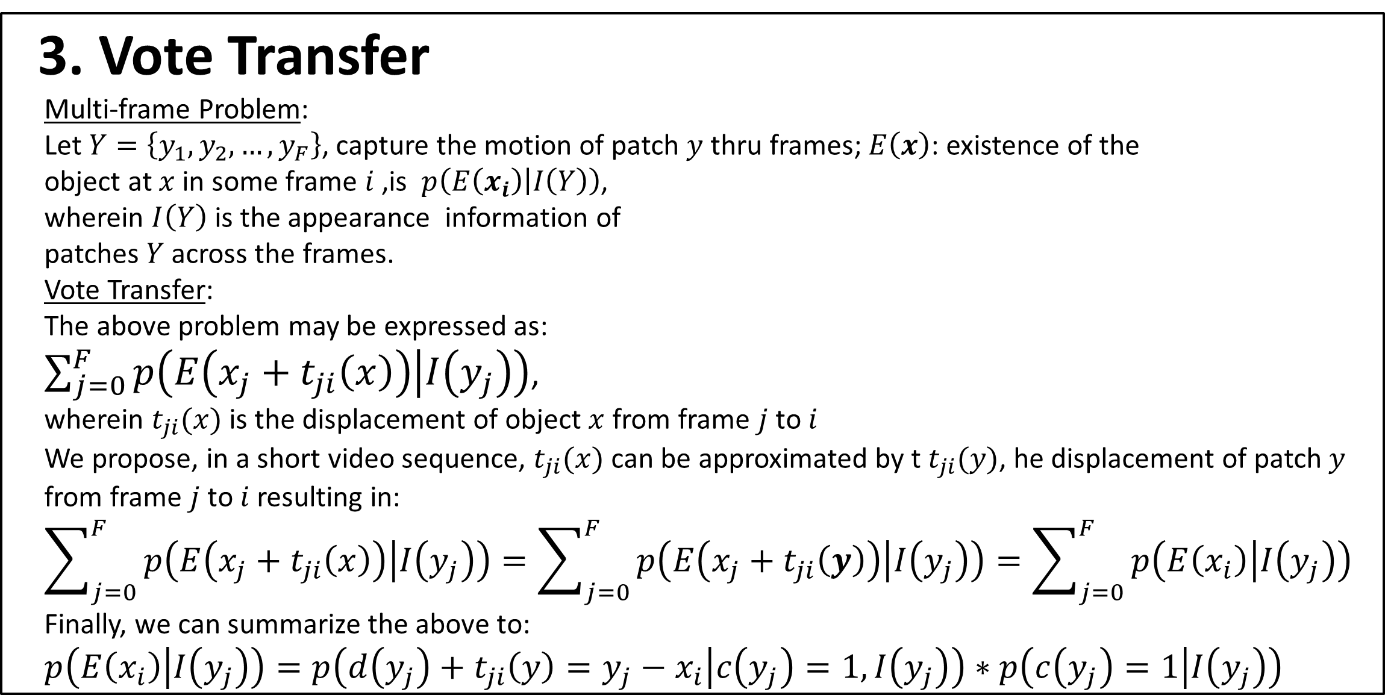
Mobile Object Detection Through Client-Server based Vote Transfer
Shyam Sunder Kumar Min Sun Silvio Savarese
Dept. of Electrical and Computer Engineering, University of Michigan at Ann Arbor, U.S.A.
Vision Lab
1. Overview
We present a novel multi-frame object detector by generalizing the Hough Forests [1] technique. Key features include:
Novel multi-frame object detection scheme
for mobile applications.
Novel multi-frame voting technique called Vote Transfer
Mobile Implementation with non-trivial client-server flow
Desktop vs. client-server performance comparison
Extensive experimental analysis
4. Mobile Implementation: Client – Server
Client:
1) Image Sequence Capture 2) Feature Extraction
Server:
1) Random forest set-up for object categories 2) Codeword Labeling
3)Hough Voting across scales and frames 4) Vote Transfer
6. Experimental Results
Analyses:
Single vs. Multi-frame for bicycle, car, and mouse.
Resolution performance
Tracking Analysis
(LK vs. LDOF)
Client
Server
2. Hough Forest
Define a patch $P\left(y\right)=\{I\left(y\right),c\left(y\right),d(y)$} at $y$ in an image with appearance $I\left(y\right)$, and of type $c\left(y\right)$, and at an offset of $d\left(y\right)$from the object center.
During training, all attributes are given to build a random forest and collect the following leaf node statistics.
The probability that patch $P(y)$ come from a foreground object: $p\left(c\left(y\right)=1 \right|I(y))=(1/N)∗\sum_{i=0}^{N}{δ(c_{i}=1)}$, where $i$is the training patch index out of $N$ patches.
The probability that the object center is offset by $d(y)$ with respect to the patch location $y$
(voting direction): $p\left(d\left(y\right)\right|c\left(y\right)=1, I\left(y\right)) ⍺ \sum_{i=0}^{N}{δ\left(d=d_{i}\right)∗δ\left(c_{i}=1\right)}$.
This is summarized to:
Patch $P(y)$ will vote for object $c\left(y\right)=1$ at location x= $y−d\left(y\right)$ with probability:
$p\left(E\left(x\right) | I\left(y\right)\right)=p\left(d\left(y\right)=y−x | c\left(y\right)=1,I\left(y\right)\right)p(c\left(y\right)=1|I(y))$,
where $E\left(x\right)$ is the event the object lies at $x$. (see [1] for details about the Random forest and derivation)
Capture Input (Image / Sequence)
Scale Image
Extract Features
Tracking ( multi-frame )
Car (CSD)
Codeword Labeling
Hough Voting across image sequence and scales
Vote Transfer
Learned model
Post-process
Reference Frame
Car
Bicycle
Display Result
3. Vote Transfer
Multi-frame Problem:
Let $Y=\left\{y_{1},y_{2},…,y_{F}\right\}$, capture the motion of patch $y$ thru frames; $E\left(x\right)$: existence of the
object at $x$ in some frame $i$ ,is $p\left(E\left(x_{i}\right) | I\left(Y\right)\right)$,
wherein $I\left(Y\right)$ is the appearance information of
patches $Y$ across the frames.
Vote Transfer:
The above problem may be expressed as:
$\sum_{j=0}^{F}{p\left(E\left(x_{j}+t_{ji}\left(x\right)\right) | I\left(y_{j}\right)\right)}$,
wherein $t_{ji}(x)$ is the displacement of object $x$ from frame $j$ to $i$
We propose, in a short video sequence, $t_{ji}(x)$ can be approximated by t $t_{ji}(y)$, he displacement of patch $y$ from frame $j$ to $i$ resulting in:
$$\sum_{j=0}^{F}{p\left(E\left(x_{j}+t_{ji}\left(x\right)\right) | I\left(y_{j}\right)\right)}=\sum_{j=0}^{F}{p\left(E\left(x_{j}+t_{ji}\left(y\right)\right) | I\left(y_{j}\right)\right)}=\sum_{j=0}^{F}{p\left(E\left(x_{i}\right) | I\left(y_{j}\right)\right)}$$
Finally, we can summarize the above to:
$$p\left(E\left(x_{i}\right) | I\left(y_{j}\right)\right)=p\left(d\left(y_{j}\right)+t_{ji}\left(y\right)=y_{j}−x_{i} | c\left(y_{j}\right)=1,I\left(y_{j}\right)\right)∗p\left(c\left(y_{j}\right)=1 | I\left(y_{j}\right)\right)$$
5. Mobile Implementation Evaluation
a) Desktop vs. Mobile Device
b) Time Breakdown on Device
LK: Lucas Kanade; FE: Feature Extraction; CS: Client-to-Server communication; RF: Random Forest; HV: Hough Voting;
SC: Server to Client communication;
Platform: Motorola Atrix running Android 2.2. on images of size 640x480 for detection.
7. Conclusion
Introduced a new multi-frame object detection scheme which is a generalization of [1].
Shown the significance of our method with experiments using two real-world datasets.
Demonstrated that object detection and categorization is feasible on commercial mobile platforms
Time (ms) | Random Forest | Hough Voting | Total
on device | 19609 | 52666 | ~70s
on desktop | 6349 | 13872 | ~20s
Time (ms) | LK | FE | CS | RF | HV | SC | Total
1 frame | N/A | 300 | 650 | 456 | 1453 | ~20 | 2.9s
5 frames | 2430 | 1700 | 1200 | 6735 | 16773 | ~20 | 28.9s
Acknowledgements
Gigascale Research Center, Google Research Award, Anush Mohan & Giovanni Zhang
References:
[1] J. Gall and V. Lempitsky. Class-speciﬁc Hough forests for object detection. In CVPR, 2009.
[2] B. Lucas, T. Kanade, et al. An iterative image registration technique with an application to stereo vision. International joint conference on AI, 1981.
[3] T. Brox, C. Bregler, and J.Malik. Large displacement optical ﬂow. In CVPR, 2009.
[4] M. Ozuysal, V. Lepetit, and P. Fua. Pose estimation for category speciﬁc multiview object localization. In CVPR, 2009.

