Slide 1
Feature-Enhanced Probabilistic Models for Diffusion Network Inference
Stefano Ermon
ECML-PKDD
September 26, 2012
Joint work with Liaoruo Wang and John E. Hopcroft

Slide 2
Background
Diffusion processes common in many types of networks
Cascading examples
contact networks <> infections
friendship networks <> gossips
social networks <> products
academic networks <> ideas

Slide 3
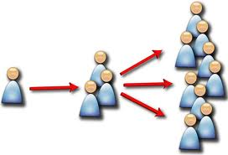
Background
Typically, network structure assumed known
Many interesting questions
minimize spread (vaccinations)
maximize spread (viral marketing)
interdictions
What if the underlying network is unknown?

Slide 4
Network Inference
NetInf [Gomez-Rodriguez et al. 2010]
input: actual number of edges in the latent network
observations of information cascades
output: set of edges maximizing the likelihood of the observations
submodular
NetRate [Gomez-Rodriguez et al. 2011]
input: observations of information cascades
output: set of transmission rates maximizing the likelihood of the observations
convex optimization problem

Slide 5
Cascades
Given observations of a diffusion process, what can we infer about the underlying network?
(v₅,t₀²)
(v₆,t₁²)
(v₉,t₀³)
(v₂,t₂²)
(v₃,t₁³)
(v₀,t₀¹)
(v₁,t₁¹)
(v₂,t₂¹)
(v₃,t₃¹)
(v₄,t₄¹)
(v₇,t₂³)
(v₁₁,t₄³)
(v₁₀,t₃³)
(v₇,t₃²)
(v₈,t₄²)
Notes:
An example of intersecting cascades of infection events.

Slide 6
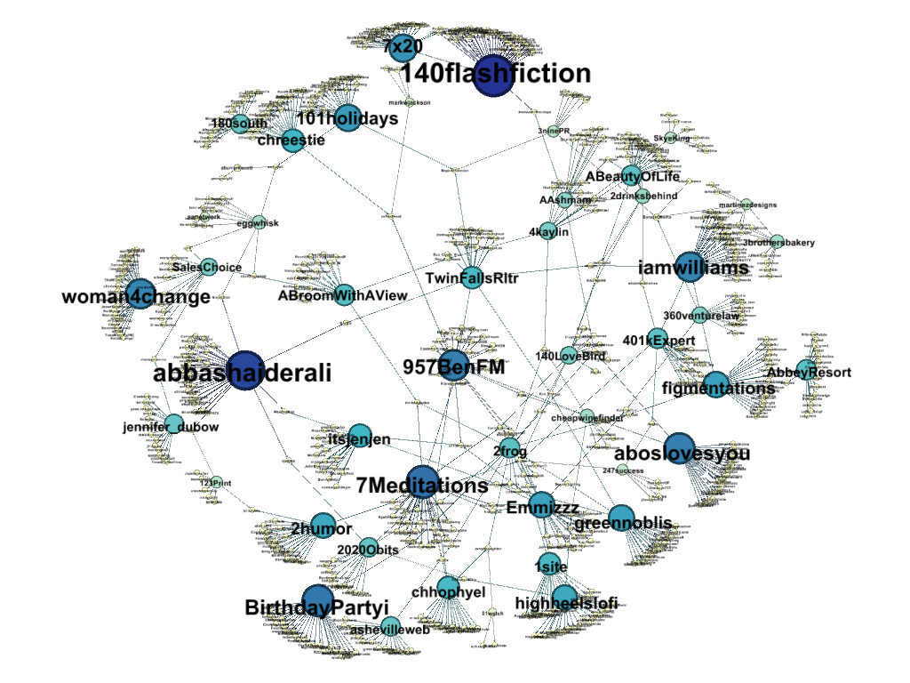
Motivating Example
information diffusion in the Twitter following network
Notes:
This example was constructed by observing the spread of the hashtag #followfriday through the Twitter network. Every node represents a user account that posts about #followfriday. Every edge represents a following relation. We can observe a clear sparkling pattern in this figure. The bigger and darker nodes are the hubs of information diffusion. The information travels from hub to hub and from hub to others.

Slide 7
Previous Work
Major assumptions
the diffusion process is causal (not affected by events in the future)
the diffusion process is monotonic (can be infected at most once)
infection events closer in time are more likely to be causally related (e.g., exponential, Rayleigh, or power-law distribution)
Time-stamps are not sufficient
most real-world diffusion processes are recurrent
cascades are often a mixture of (geographically) local sub-cascades
cannot tell them apart by just looking at time-stamps
many other informative factors (e.g., language, pairwise similarity)
Our work generalizes previous models to take these factors into account.

Slide 8
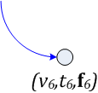
Problem Definition
Weighted, directed graph G=(V, E)
known: node set V
unknown: weighted edge set E
Observations: generalized cascades {π¹, π²,…, π^{M}}
957BenFM
#ladygaga always rocks…
2frog
#ladygaga bella canzone…
AbbeyResort
#followfriday
see you all tonight…
figmentations
#followfriday
cannot wait…
2frog
#followfriday
周五活动计划…

Slide 9
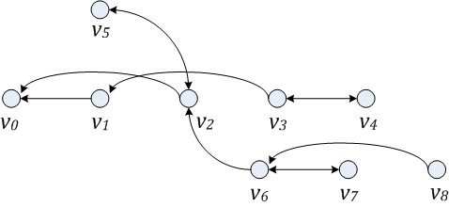
Problem Definition
Given
set of vertices V
set of generalized cascades {π¹, π²,…, π^{M}}
generative probabilistic model (feature-enhanced)
Goal: find the most likely adjacency matrix of transmission
rates A={α_{jk}|j,k∈V,j≠k}
observed cascades
{π¹, π²,…, π^{M}}
latent network

Slide 10
Feature-Enhanced Model
Multiple occurrences
splitting:
an infection event of a node is the result of all previous events up to its last infection (memoryless)
non-splitting:
an infection event is the result of all previous events
Independent of future infection events (causal process)

Slide 11
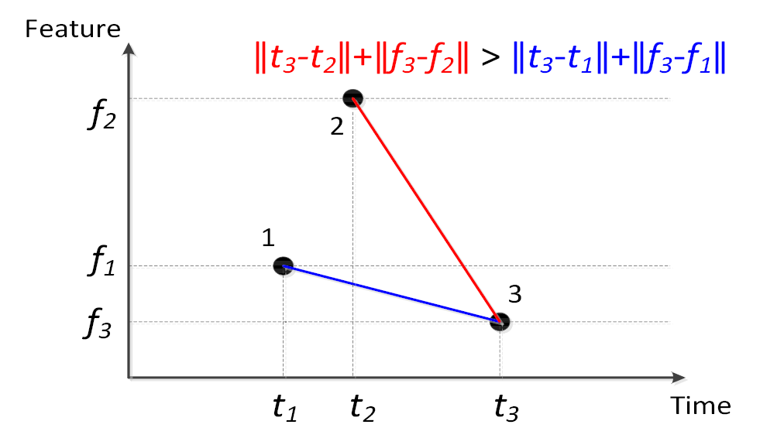
Feature-Enhanced Model
Generalized cascade:
assumption 1:
events closer in time are more likely to be causally related
assumption 2:
events closer in feature space are more likely to be causally related

Slide 12
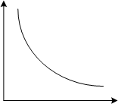
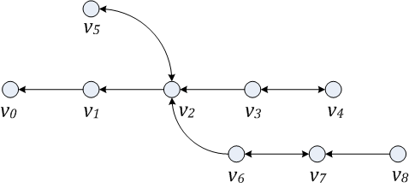
Generative Model
probability of being causally related
distance between events
diffusion distribution (exponental, Rayleigh, etc.)
assumed network A
Given model and observed cascades, the likelihood of an assumed network A:
enough edges so that every infection event can be explained (reward)
for every infected node, for each of its neighbors,
how long does it take for the neighbor to become infected? (penalty)
why not infected at all? (penalty)

Slide 13
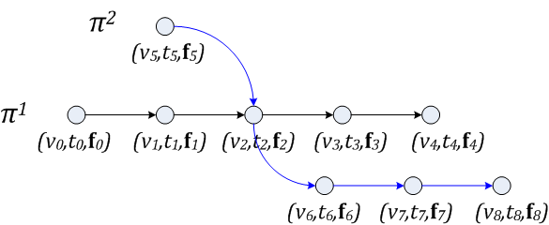
Optimization Framework
diffusion distribution (exponental, Rayleigh, etc.)
assumed network A
maximize L(π¹, π² |A)
convex in A
decomposable
Notes:
Similar to previous work in gomes-rodrigues

Slide 14
Experimental Setup
Dataset
Twitter (66,679 nodes; 240,637 directed edges)
Cascades (500 hashtags; 103,148 tweets)
Ground truth known
Feature Model
language
pairwise similarity
combination

Slide 15
Experimental Setup
Baselines
NetInf (takes true number of edges as input)
NetRate
Language Detector
the language is computed using the n-gram model
noisy estimates
Convex Optimization
limited-memory BFGS algorithm with box constraints
CVXOPT cannot handle the scale of our Twitter dataset
All algorithms are implemented using Python with the Fortran implementation of LBFGS-B available in Scipy, and all experiments are performed on a machine running CentOS Linux with a 6-core Intel x5690 3.46GHZ CPU and 48GB memory.

Slide 16
Performance Comparison
Non-Splitting Exponential
Metric | NetInf | NetRate | moNet | moNet+L | moNet+J | moNet+LJ
Precision | 0.362 | 0.592 | 0.434 | 0.464 | 0.524 | 0.533
Recall | 0.362 | 0.069 | 0.307 | 0.374 | 0.450 | 0.483
F1-score | 0.362 | 0.124 | 0.359 | 0.414 | 0.484 | 0.507
TP | 518 | 99 | 439 | 535 | 644 | 692
FP | 914 | 62 | 573 | 618 | 586 | 606
FN | 914 | 1333 | 993 | 897 | 788 | 740
0.362
0.362
0.592
0.069
66%
Notes:
Since netinf knows how many edges there are, precision is equal to recall in this case. While netrate has pretty good precision, recall is very low, which means netrate is overly conservative.

Slide 17
Performance Comparison
Splitting Exponential
Metric | NetInf | NetRate | moNet | moNet+L | moNet+J | moNet+LJ
Precision | 0.362 | 0.592 | 0.514 | 0.516 | 0.531 | 0.534
Recall | 0.362 | 0.069 | 0.599 | 0.605 | 0.618 | 0.635
F1-score | 0.362 | 0.124 | 0.554 | 0.557 | 0.571 | 0.581
TP | 518 | 99 | 858 | 867 | 885 | 910
FP | 914 | 62 | 810 | 812 | 781 | 793
FN | 914 | 1333 | 574 | 565 | 547 | 522
79%

Slide 18
Performance Comparison
Non-Splitting Rayleigh
Metric | NetInf | NetRate | moNet | moNet+L | moNet+J | moNet+LJ
Precision | 0.354 | 0.560 | 0.420 | 0.454 | 0.479 | 0.484
Recall | 0.354 | 0.072 | 0.218 | 0.262 | 0.286 | 0.294
F1-score | 0.354 | 0.127 | 0.287 | 0.332 | 0.358 | 0.366
TP | 507 | 103 | 312 | 375 | 409 | 421
FP | 925 | 81 | 430 | 451 | 445 | 449
FN | 925 | 1329 | 1120 | 1057 | 1023 | 1011
0.354
0.354
0.560
0.072
65%

Slide 19
Performance Comparison
Splitting Rayleigh
Metric | NetInf | NetRate | moNet | moNet+L | moNet+J | moNet+LJ
Precision | 0.354 | 0.560 | 0.480 | 0.493 | 0.495 | 0.499
Recall | 0.354 | 0.072 | 0.562 | 0.566 | 0.570 | 0.572
F1-score | 0.354 | 0.127 | 0.518 | 0.527 | 0.530 | 0.533
TP | 507 | 103 | 805 | 811 | 816 | 819
FP | 925 | 81 | 872 | 835 | 834 | 821
FN | 925 | 1329 | 627 | 621 | 616 | 613
76%
Notes:
Splitting Exponential is a better model for information diffusion in Twitter.

Slide 20
Conclusion
Feature-enhanced probabilistic models to infer the latent network from observations of a diffusion process
Primary approach moNet with non-splitting and splitting solutions to handle recurrent processes
Our models consider not only the relative time differences between infection events, but also a richer set of features.
The inference problem still involves convex optimization. It can be decomposed into smaller sub-problems that we can efficiently solve in parallel.
Improved performance on Twitter

Slide 21
THANK YOU!

