Slide 1
Scalable Learning in Computer Vision
Adam Coates
Honglak Lee
Rajat Raina
Andrew Y. Ng
Stanford University

Slide 2
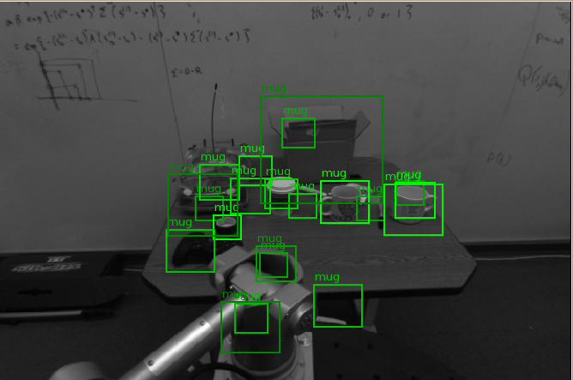
Computer Vision is Hard

Slide 3
Introduction
One reason for difficulty: small datasets.
Common Dataset Sizes (positives per class)
Caltech 101 | 800
Caltech 256 | 827
PASCAL 2008 (Car) | 840
PASCAL 2008 (Person) | 4168
LabelMe (Pedestrian) | 25330
NORB (Synthetic) | 38880

Slide 4
Introduction
But the world is complex.
  Hard to get extremely high accuracy on real images if we haven’t seen enough examples.
AUC
Training Set Size

Slide 5
Introduction
Small datasets:
  Clever features
    Carefully design to be robust to lighting, distortion, etc.
  Clever models
    Try to use knowledge of object structure.
  Some machine learning on top.
Large datasets:
  Simple features
    Favor speed over invariance and expressive power.
  Simple model
    Generic; little human knowledge.
  Rely on machine learning to solve everything else.

Slide 6
Supervised Learning from synthetic data

Slide 7
The Learning Pipeline
Need to scale up each part of the learning process to really large datasets.
Image
Data
Learning
Algorithm
Low-level features

Slide 8
Synthetic Data
Not enough labeled data for algorithms to learn all the knowledge they need.
  Lighting variation
  Object pose variation
  Intra-class variation
Synthesize positive examples to include this knowledge.
  Much easier than building this knowledge into the algorithms.

Slide 9
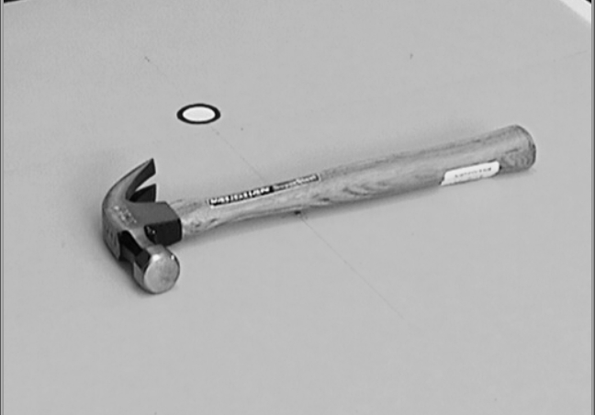
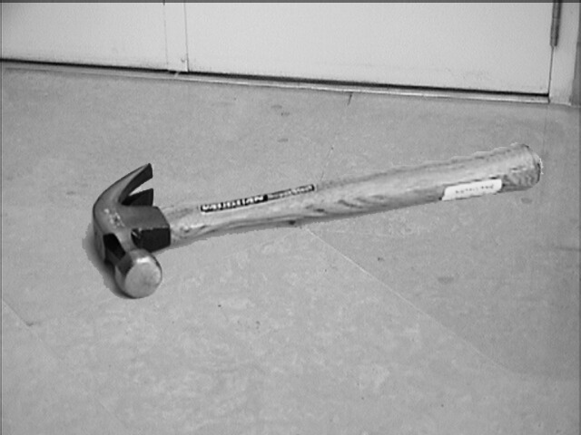
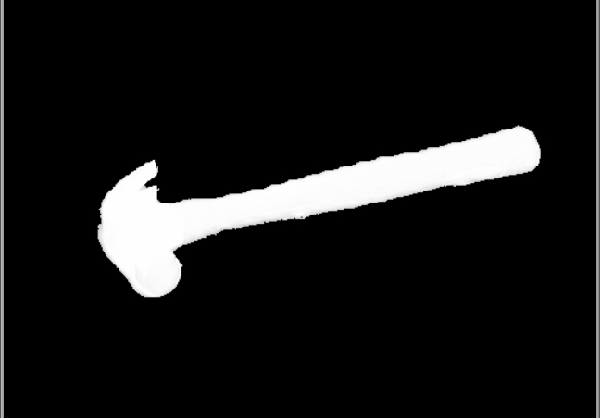
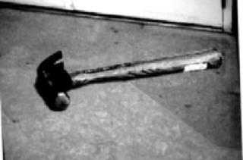
Synthetic Data
Collect images of object on a green-screen turntable.
Green Screen image
Synthetic Background
Segmented Object
Photometric/Geometric Distortion

Slide 10
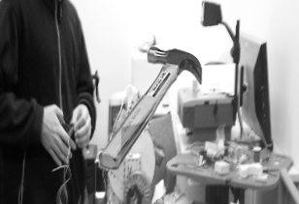
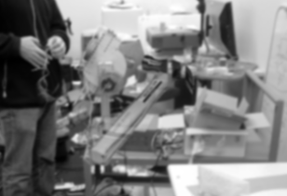
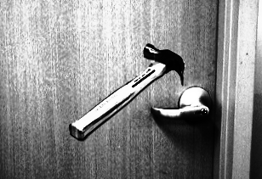
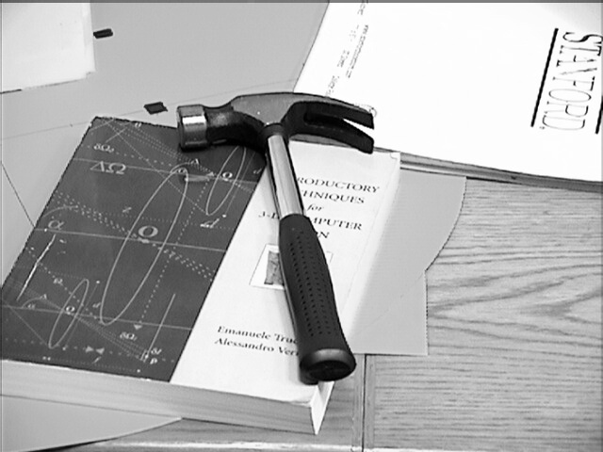
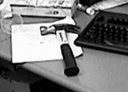
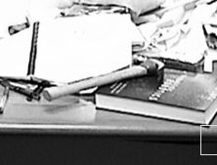
Synthetic Data: Example
Claw hammers:
Synthetic Examples (Training set)
Real Examples (Test set)

Slide 11
The Learning Pipeline
Feature computations can be prohibitive for large numbers of images.
  E.g., 100 million examples x 1000 features.
  → 100 billion feature values to compute.
Image
Data
Learning
Algorithm
Low-level features

Slide 12
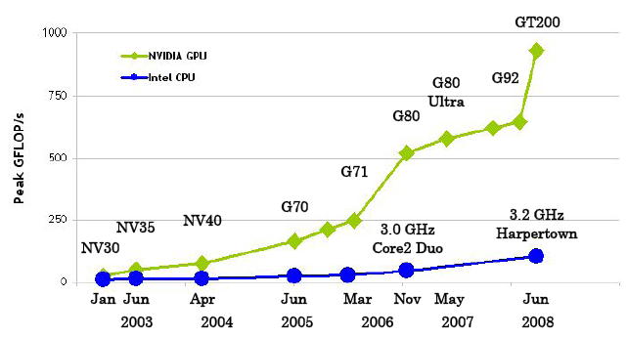
Features on CPUs vs. GPUs
Difficult to keep scaling features on CPUs.
  CPUs are designed for general-purpose computing.
GPUs outpacing CPUs dramatically.
(nVidia CUDA Programming Guide)

Slide 13
Features on GPUs
Features: Cross-correlation with image patches.
  High data locality; high arithmetic intensity.
Implemented brute-force.
  Faster than FFT for small filter sizes.
  Orders of magnitude faster than FFT on CPU.
20x to 100x speedups (depending on filter size).

Slide 14
The Learning Pipeline
Large number of feature vectors on disk are too slow to access repeatedly.
  E.g., Can run an online algorithm on one machine, but disk access is a difficult bottleneck.
Image
Data
Learning
Algorithm
Low-level features

Slide 15
Distributed Training
Solution: must store everything in RAM.
No problem!
  RAM as low as $20/GB
Our cluster with 120GB RAM:
  Capacity of >100 million examples.
    For 1000 features, 1 byte each.

Slide 16
Distributed Training
Algorithms that can be trained from sufficient statistics are easy to distribute.
Decision tree splits can be trained using histograms of each feature.
  Histograms can be computed for small chunks of data on separate machines, then combined.
Split
+
=
x
x
x
Slave 1
Slave 2
Master
Master

Slide 17
The Learning Pipeline
We’ve scaled up each piece of the pipeline by a large factor over traditional approaches:
> 1000x
20x – 100x
> 10x
Image
Data
Learning
Algorithm
Low-level features

Slide 18
Size Matters
AUC
Training Set Size

Slide 19
UNSUPERVISED FEATURE LEARNING

Slide 20

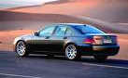
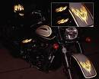






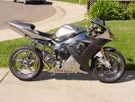



Traditional supervised learning
Cars
Motorcycles
Testing:
What is this?

Slide 21

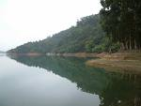
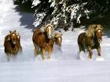

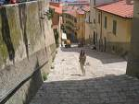

Self-taught learning
Natural scenes
Testing:
What is this?
Car
Motorcycle

Slide 22
Learning representations
Image
Data
Learning
Algorithm
Low-level features
Where do we get good low-level representations?

Slide 23
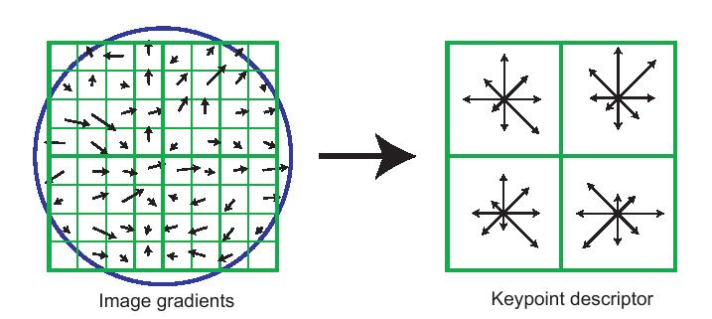
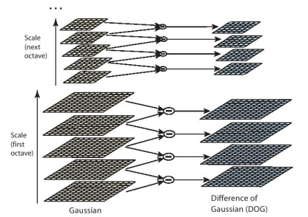
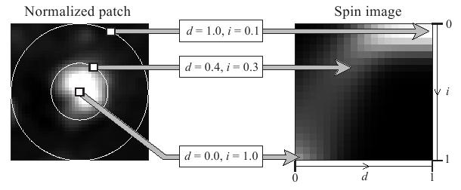
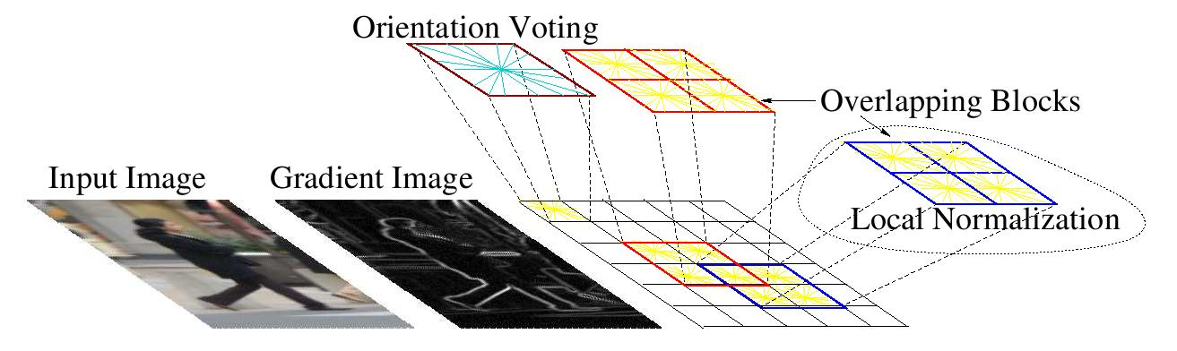
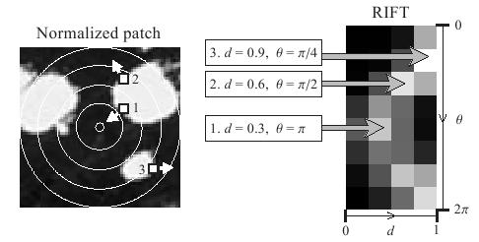
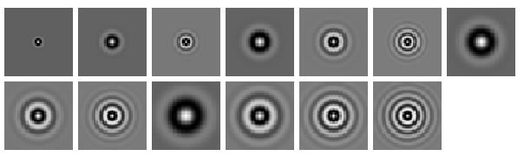
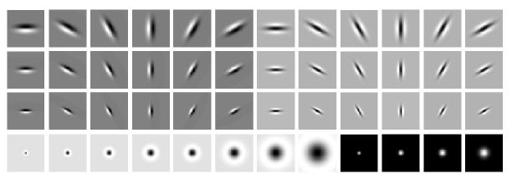
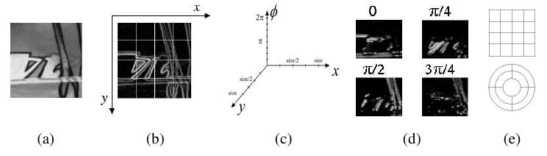
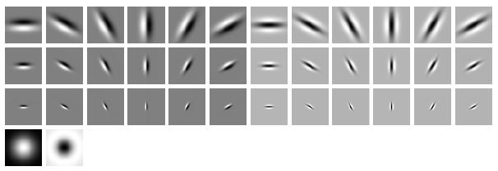
Computer vision features
SIFT
Spin image
HoG
RIFT
Textons
GLOH

Slide 24
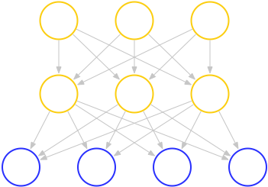
Unsupervised feature learning
Higher layer
(Combinations
of edges; cf.V2)
“Sparse coding”
(edges; cf. V1)
Input image (pixels)
DBN (Hinton et al., 2006) with additional sparseness constraint.
[Related work: Hinton, Bengio, LeCun, and others.]
Note: No explicit “pooling.”

Slide 25
Unsupervised feature learning
Higher layer
(Model V3?)
Higher layer
(Model V2?)
Model V1
Input image
Very expensive to train.
  > 1 million examples.
  > 1 million parameters.

Slide 26
Learning Large RBMs on GPUs
Dual-core CPU
2 weeks
1 week
Learning time for 10 million examples
(log scale)
35 hours
72x faster
1 day
8 hours
2 hours
GPU
5 hours
1 hour
½ hour
1 18 36 45
Millions of parameters
(Rajat Raina, Anand Madhavan, Andrew Y. Ng)

Slide 27

Learning features
Can now train very complex networks.
Can learn increasingly complex features.
Both more specific and more general-purpose than hand-engineered features.
Object models
Object parts
(combination
of edges)
Edges
Pixels

Slide 28
Conclusion
Performance gains from large training sets are significant, even for very simple learning algorithms.
  Scalability of the system allows these algorithms to improve “for free” over time.
Unsupervised algorithms promise high-quality features and representations without the need for hand-collected data.
GPUs are a major enabling technology.

Slide 29
THANK YOU

