Slide 1

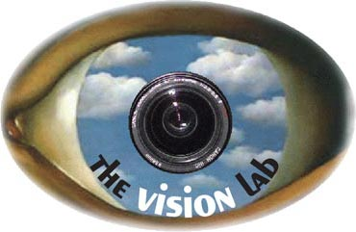


Grouplet: A Structured Image Representation for Recognizing Human and Object Interactions
Bangpeng Yao and Li Fei-Fei
Computer Science Department, Stanford University
{bangpeng,feifeili}@cs.stanford.edu

Slide 2
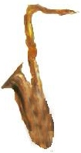
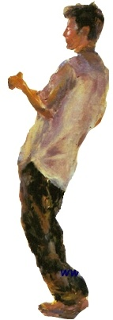
Human-Object Interaction
Playing saxophone
Human
Not playing saxophone
Saxophone

Slide 3
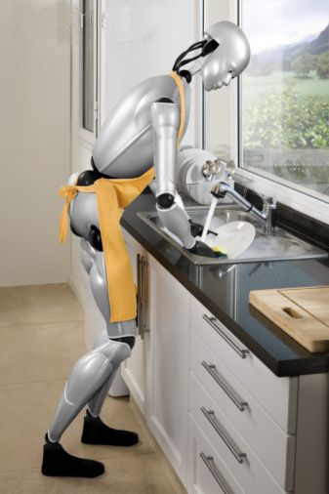
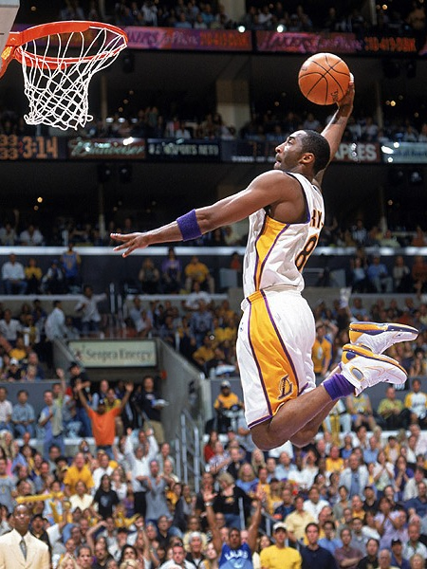
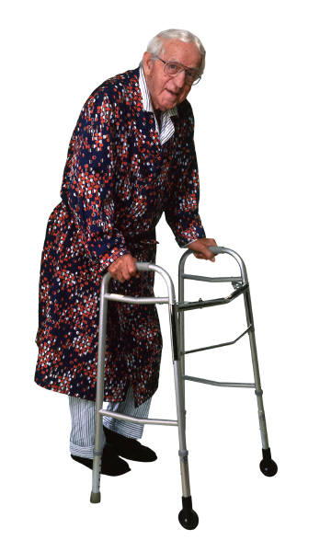
Human-Object Interaction
Robots interact with objects
Automatic sports commentary
Medical care
“Kobe is dunking the ball.”

Slide 4
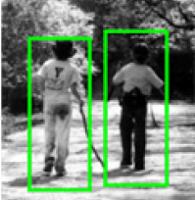
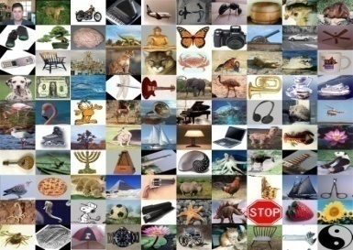
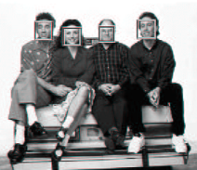


Background: Human-Object Interaction
To be done
Schneiderman & Kanade, 2000
Viola & Jones, 2001
Huang et al, 2007
Papageorgiou & Poggio, 2000
Wu & Nevatia, 2005
Dalal & Triggs, 2005
Mikolajczyk et al, 2005
Leibe et al, 2005
Bourdev & Malik, 2009
Felzenszwalb & Huttenlocher, 2005
Ren et al, 2005
Ramanan, 2006
Ferrari et al, 2008
Yang & Mori, 2008
Andriluka et al, 2009
Eichner & Ferrari, 2009
Lowe, 1999
Belongie et al, 2002
Fergus et al, 2003
Fei-Fei et al, 2004
Berg & Malik, 2005
Felzenszwalb et al, 2005
Grauman & Darrell, 2005
Sivic et al, 2005
Lazebnik et al, 2006
Zhang et al, 2006
Savarese et al, 2007
Lampert et al, 2008
Desai et al, 2009
Gehler & Nowozin, 2009
vs.
Gupta et al, 2009
Yao & Fei-Fei, 2010a
Yao & Fei-Fei, 2010b
context
Murphy et al, 2003
Hoiem et al, 2006
Shotton et al, 2006
Rabinovich et al, 2007
Heitz & Koller, 2008
Divvala et al, 2009

Slide 5
Background: Human-Object Interaction
To be done
Schneiderman & Kanade, 2000
Viola & Jones, 2001
Huang et al, 2007
Papageorgiou & Poggio, 2000
Wu & Nevatia, 2005
Dalal & Triggs, 2005
Mikolajczyk et al, 2005
Leibe et al, 2005
Bourdev & Malik, 2009
Felzenszwalb & Huttenlocher, 2005
Ren et al, 2005
Ramanan, 2006
Ferrari et al, 2008
Yang & Mori, 2008
Andriluka et al, 2009
Eichner & Ferrari, 2009
Lowe, 1999
Belongie et al, 2002
Fergus et al, 2003
Fei-Fei et al, 2004
Berg & Malik, 2005
Felzenszwalb et al, 2005
Grauman & Darrell, 2005
Sivic et al, 2005
Lazebnik et al, 2006
Zhang et al, 2006
Savarese et al, 2007
Lampert et al, 2008
Desai et al, 2009
Gehler & Nowozin, 2009
vs.
Gupta et al, 2009
Yao & Fei-Fei, 2010a
Yao & Fei-Fei, 2010b
context
Murphy et al, 2003
Hoiem et al, 2006
Shotton et al, 2006
Rabinovich et al, 2007
Heitz & Koller, 2008
Divvala et al, 2009

Slide 6
Outline
Intuition of Grouplet Representation
Grouplet Feature Representation
Using Grouplet for Recognition
Dataset & Experiments
Conclusion

Slide 7
Outline
Intuition of Grouplet Representation
Grouplet Feature Representation
Using Grouplet for Recognition
Dataset & Experiments
Conclusion

Slide 8
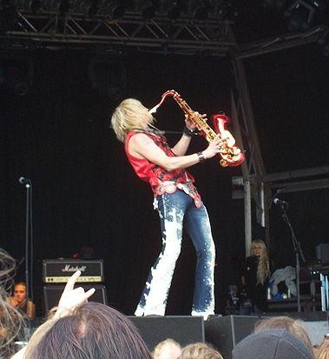
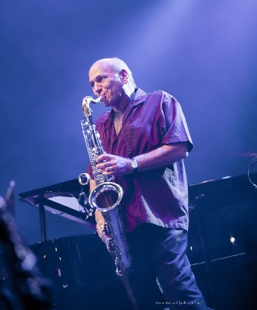
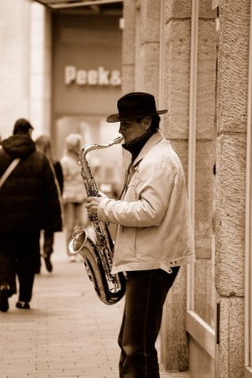
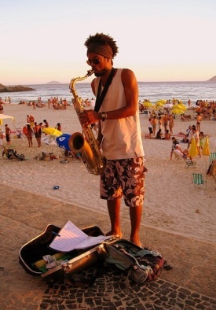
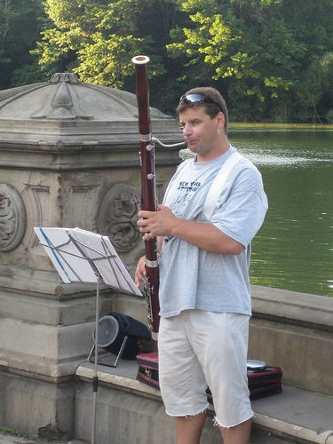
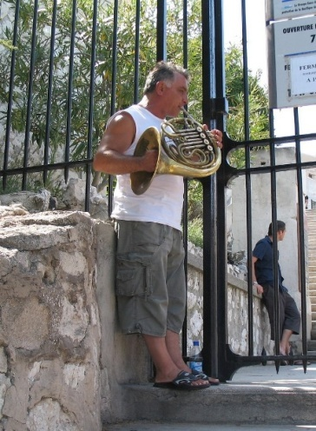
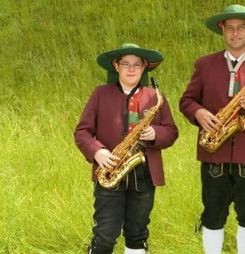
Recognizing Human-Object Interaction is Challenging
Reference image: playing saxophone
Different pose (or viewpoint)
Different lighting
Different background
Different instrument, similar pose
Same object (saxophone), different interactions

Slide 9
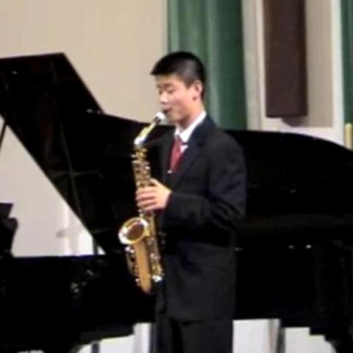





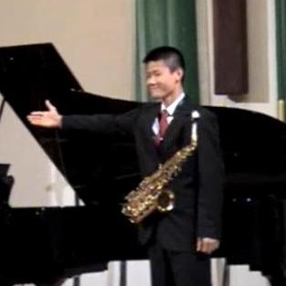





Grouplet: our intuition
Bag-of-words
Spatial pyramid
Part-based
Grouplet Representation:
Thomas & Malik, 2001
Csurka et al, 2004
Fei-Fei & Perona, 2005
Sivic et al, 2005
Grauman & Darrell, 2005
Lazebnik et al, 2006
Weber et al, 2000
Fergus et al, 2003
Leibe et al, 2004
Felzenszwalb et al, 2005
Bourdev & Malik, 2009
Notes:
Some people may ask the difference between our work and the Hough voting approaches.

Slide 10
Grouplet: our intuition
Grouplet Representation:
Part-based configuration
Co-occurrence
Discriminative
Dense
Capture the subtle difference in human-object interactions.

Slide 11
Outline
Intuition of Grouplet Representation
Grouplet Feature Representation
Using Grouplet for Recognition
Dataset & Experiments
Conclusion

Slide 12
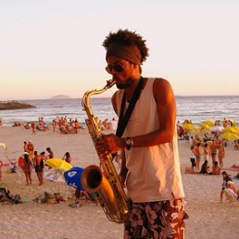
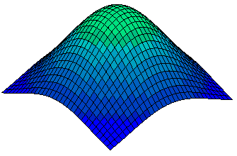
Grouplet representation (e.g. 2-Grouplet)
Notations
I: Image.
P: Reference point in the image.
Λ: Grouplet.
λ_{i}: Feature unit.
A_{i}: Visual codeword;
x_{i}: Image location;
σ_{i}: Variance of spatial distribution.
Visual codewords
Gaussian distribution
Notes:
Given an image and 【c】 a reference point, 【c】the grouplet feature considers the co-occurrence of a set of highly-related image patches. 【c】Those patches are encoded by feature units, which models specific appearance and location information. 【c】The appearance information is represented by a visual codeword, 【c】while the location information is represented by a 2D Gaussian distribution.
Here we show a two-grouplet, which contains two feature units.

Slide 13
Grouplet representation (e.g. 2-Grouplet)
Notations
I: Image.
P: Reference point in the image.
Λ: Grouplet.
λ_{i}: Feature unit.
ν(Λ,I): Matching score of Λ and I.
ν(λ_{i},I): Matching score of λ_{i} and I.
A_{i}: Visual codeword;
x_{i}: Image location;
σ_{i}: Variance of spatial distribution.
Visual codewords
Gaussian distribution
Matching score between Λ and I
Matching score between λ_{i} and I
Notes:
Given an image of human and object interaction 【c】 with the center of human face as reference point, 【c】 we need to calculate the matching score between the image and the grouplet, which measures the likelihood of observing the grouplet in the image. Because the grouplet requires the co-occurrence of all its feature units, therefore the 【c】 matching score between the image and the grouplet is the minimum value of the scores between the image and each feature unit in the grouplet.

Slide 14
Grouplet representation (e.g. 2-Grouplet)
Notations
I: Image.
P: Reference point in the image.
Λ: Grouplet.
λ_{i}: Feature unit.
ν(Λ,I): Matching score of Λ and I.
ν(λ_{i},I): Matching score of λ_{i} and I.
For an image patch:
Ω(x): Image neighborhood of x.
A_{i}: Visual codeword;
x_{i}: Image location;
σ_{i}: Variance of spatial distribution.
a′: Its visual appearance;
x′: Its image location.
Visual codewords
Gaussian distribution
Matching score between Λ and I
Matching score between λ_{i} and I
Codeword assignment score
Gaussian density value
Notes:
Given one feature unit, we consider the image patches in the neighborhood of the center of the Gaussian distribution, 【c】 and measure the probability of assigning each patch to the codeword of the feature unit.

Slide 15
Grouplet representation (e.g. 2-Grouplet)
Notations
I: Image.
P: Reference point in the image.
Λ: Grouplet.
λ_{i}: Feature unit.
ν(Λ,I): Matching score of Λ and I.
ν(λ_{i},I): Matching score of λ_{i} and I.
For an image patch:
Ω(x): Image neighborhood of x.
Δ: A small shift of the location.
A_{i}: Visual codeword;
x_{i}: Image location;
σ_{i}: Variance of spatial distribution.
a′: Its visual appearance;
x′: Its image location.
Visual codewords
Gaussian distribution
Matching score between Λ and I
Matching score between λ_{i} and I
Codeword assignment score
Gaussian density value
Codeword assignment score
Gaussian density value
Notes:
Furthermore, in order to allow the feature unit to be more resistant to small spatial variations, we allow the Gaussian distribution to shift in its small neighborhood, which will result to a set of matching scores, 【c】 and their maximum value will be taken as the matching score of the feature unit and the image.

Slide 16
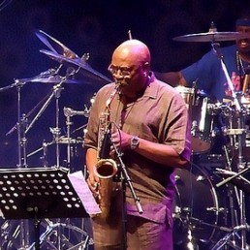
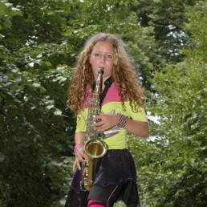
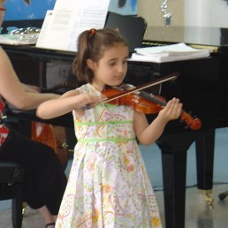
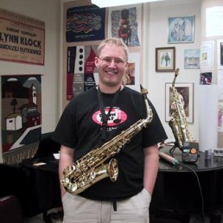
Grouplet representation
Part-based configuration
Co-occurrence
Discriminative
Playing saxophone
Other interactions
matching score: 0.6
matching score: 0.4
matching score: 0.0
matching score: 0.1

Slide 17
Grouplet representation
Part-based configuration
Co-occurrence
Discriminative
Dense
All possible combinations of feature units
Densely sample image locations
Many possible spatial distributions
All possible Codewords
1-grouplet
2-grouplet
3-grouplet

Slide 18
Outline
Intuition of Grouplet Representation
Grouplet Feature Representation
Using Grouplet for Recognition
Dataset & Experiments
Conclusion

Slide 19
A “Space” of Grouplets

Slide 20
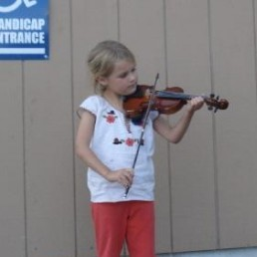

A “Space” of Grouplets
Playing violin
Other interactions

Slide 21
A “Space” of Grouplets
Playing saxophone
Other interactions
Playing violin
Other interactions

Slide 22
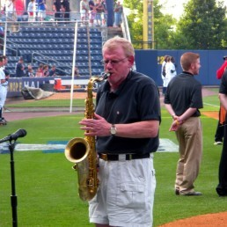

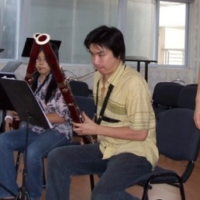
A “Space” of Grouplets
Playing saxophone
Other interactions
Playing violin
Other interactions
On background
Shared by different interactions

Slide 23
We only need discriminative Grouplets
Playing saxophone
Other interactions
Playing violin
Other interactions
Large ν(Λ,I)
Small ν(Λ,I)
Large ν(Λ,I)
Small ν(Λ,I)
On background
Number of feature units: N.
N is large (192200)
Number of Grouplets: 2^{N}
very large space
Shared by different interactions
23

Slide 24
Obtaining discriminative grouplets for a class
Apriori Mining
Selected 1-grouplets
Obtain grouplets with large ν(Λ,I) on the class.
Remove grouplets with large ν(Λ,I) from other classes.
Candidate 2-grouplets
Mine 1000~2000 grouplets, only need to evaluate (2~100)×N grouplets
Number of feature units: N.
N is large (192200)
Number of Grouplets: 2^{N}
very large space
[Agrawal & Srikant, 1994]
Notes:
For the first step, we apply an Apriori mining approach to make it tractable. In Apriori mining, we start from 1-grouplets, which consists of one feature unit. Then we generate candidate 2-grouplets based on only the selected 1-grouplets. All the other 2-grouplets do not need to be considered. This is because in our definition, once a feature unit has a small matching score with an image, then all the grouplets contain this feature unit will also have a small matching score. The Apriori mining approach continues with the candidate 2-grouplets until all the grouplets that have large matching score with images of this class are obtained. With Apriori mining, when we want to obtain thousands of grouplets, the total number of grouplets that need to be evaluated is linear to the number of feature units instead of the exponential number in the brute force way. Furthermore, in our method, we assume an initial spatial distribution of each feature unit, and have a probabilistic model to update those distributions.

Slide 25
Using Grouplets for Classification
Discriminative grouplets
SVM

Slide 26
Outline
Intuition of Grouplet Representation
Grouplet Feature Representation
Using Grouplet for Recognition
Dataset & Experiments
Conclusion

Slide 27
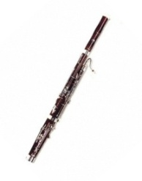
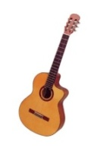
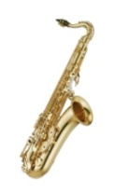
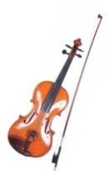
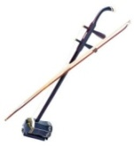
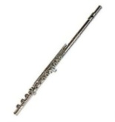
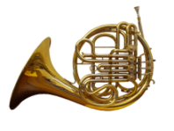
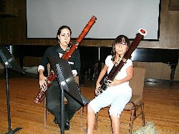

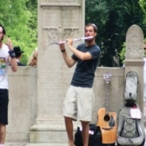
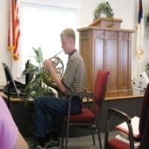
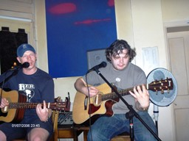
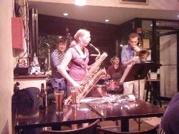

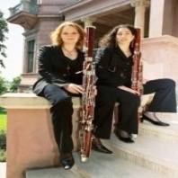

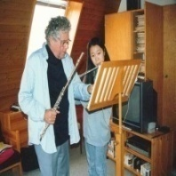
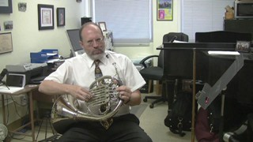

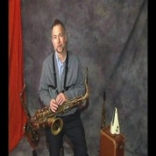
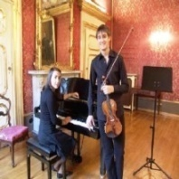
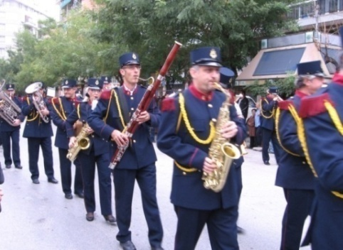
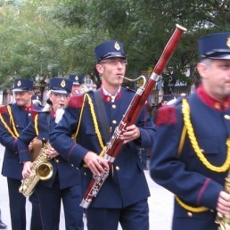
People-Playing-Musical-Instruments (PPMI) Dataset
http://vision.stanford.edu/resources_links.html
PPMI+
# Image:
(172)
(191)
(177)
(179)
(200)
(198)
(185)
PPMI-
# Image:
(164)
(148)
(133)
(149)
(188)
(169)
(167)
Original image
Normalized image
(200 images each interaction)
Notes:
However, there is not much work on activities of human-object interactions, nor a suitable data set for this problem. We therefore collect a new dataset called PPMI of people-playing-musical-instrument. Currently there are seven musical instruments. In each instrument, there are not only PPMI+ images of people playing the instrument, but also PPMI- images of a human holding the instrument without playing. Therefore this data set offers us an opportunity to understand how humans interact with the object, and this property cannot be captured by the sports data set of Gupta 2009, which might be the only existing one that involves human and object interactions. Furthermore we also normalize each original image by cropping the upper-body part of the person. Both original and normalized images are available at our website.

Slide 28
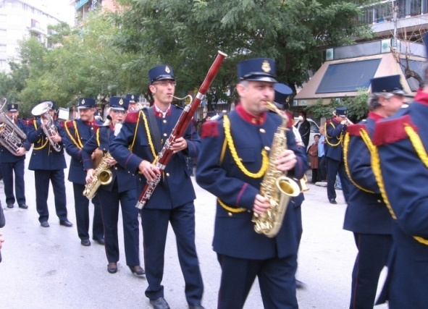
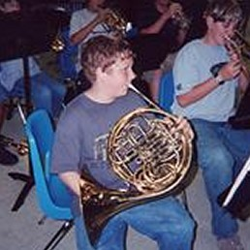
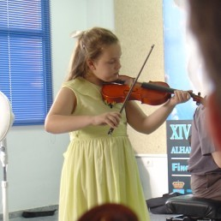
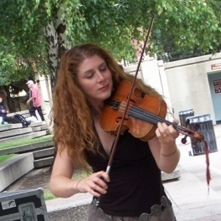

Recognition Tasks on People-Playing-Musical-Instruments (PPMI) Dataset
Classification
Detection
Playing different instruments
Playing bassoon
Playing saxophone
Playing French horn
Playing violin
Playing saxophone
vs.
Playing vs. Not playing
Playing violin
Not playing violin
vs.
For each interaction, 100 training and 100 testing images.

Slide 29
Classification: Playing Different Instruments
7-class classification on PPMI+ images
SPM: [Lazebnik et al, 2006]
DPM: [Felzenszwalb et al, 2008]
Constellation: [Fergus et al, 2003]
[Niebles & Fei-Fei, 2007]

Slide 30












Classifying Playing vs. Not playing
Seven 2-class classification problem; PPMI+ vs. PPMI- for each instrument.
SPM
Bassoon
Erhu
Flute
French horn
Saxophone
Violin
Average PPMI+ images
Average PPMI- images

Slide 31


Classifying Playing vs. Not playing
Seven 2-class classification problem; PPMI+ vs. PPMI- for each instrument.
SPM
Guitar
Average PPMI+ images
Average PPMI- images

Slide 32




Detecting people playing musical instruments
Procedure:
Face detection with a low threshold;
Crop and normalize image regions;
8-class classification
7 classes of playing instruments;
Another class of not playing any instrument.
Playing saxophone
No playing
No playing
Notes:
We also test the performance of the grouplet feature to detect people playing musical instruments on the original images. This is a very challenging problem because we also want the detector to tell which musical instrument that the human is playing. Instead of using the traditional scanning window method, we first run a face detector, based on the face detection results, we train a eight-class SVM classifier. We have eight classes because there are seven different musical instruments, and another class that the face detection result is a false alarm or the human is not playing any instrument. The preliminary results show that, our method outperforms the spatial pyramid approach on this very challenging problem.

Slide 33


Detecting people playing musical instruments
Area under the precision-recall curve:
Out method: 45.7%;
Spatial pyramid: 37.3%.
Playing saxophone
Playing saxophone
Playing bassoon
Playing French horn
Playing French horn

Slide 34
Detecting people playing musical instruments
Area under the precision-recall curve:
Out method: 45.7%;
Spatial pyramid: 37.3%.
Playing French horn
False detection
Missed detection

Slide 35




Examples of Mined Grouplets
Playing bassoon:
Playing saxophone:
Playing violin:
Playing guitar:

Slide 36

Conclusion
Holistic image-based classification
Detailed understanding and reasoning
Vs.
Playing bassoon
Playing saxophone
Playing saxophone
Pose estimation & object detection
The Next Talk
[B. Yao and L. Fei-Fei. “Grouplet: A structured image representation for recognizing human and object interactions.” CVPR 2010.]
[B. Yao and L. Fei-Fei. “Modeling mutual context of object and human pose in human-object interaction activities.” CVPR 2010.]

Slide 37


Thanks to
Juan Carlos Niebles, Jia Deng, Jia Li, Hao Su, Silvio Savarese, and anonymous reviewers.
And You

