Slide 1
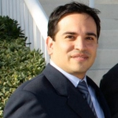


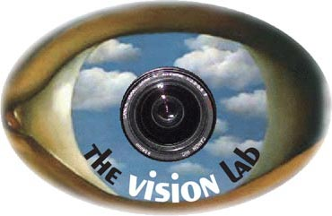

Modeling Temporal Structure of Decomposable Motion Segments for Activity Classification
Juan Carlos Niebles
Chih-Wei Chen
Li
Fei-Fei
Computer Science Dept.
Stanford University

Slide 2
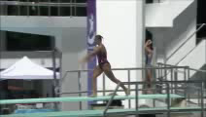
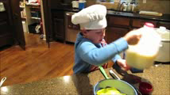
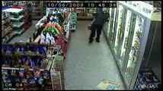
Recognizing Human Activities
Motion Analysis
Judge Sports Automatically
Biomechanics
Video game interfaces
Interactions with Objects
Temporal structure & causality
Provide cooking assistance
…
Detect unusual behavior
Smart surveillance
Psychology studies

Slide 3
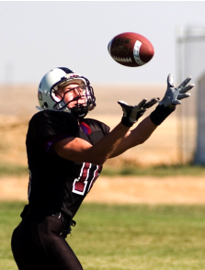
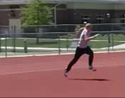
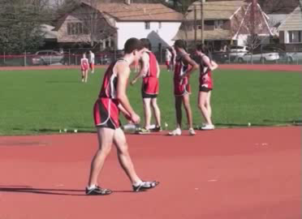
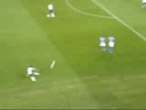
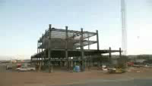
Activity landscape
Activities
Events
Long term event
Snapshot
Atomic action
Construction of a building
Catch
Run
High Jump
Football
10⁻¹
10⁰
10¹
10³
10⁷⁻⁸
Temporal Scale (seconds)

Slide 4
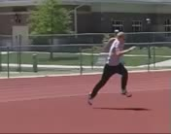
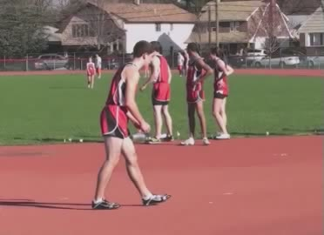
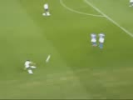

Activity landscape
Activities
Events
Long term event
Snapshot
Atomic action
Construction of a building
Catch
Run
High Jump
Football
10⁻¹
10⁰
10¹
10³
10⁷⁻⁸
Thurau & Hlavac, 2008
Gupta et al, 2009
Ikizler & Duygulu, 2009
Ikizler-Cinbis et al, 2009
Yao & Fei-Fei 2010a,b
Yang, Wang and Mori, 2010
Bobick & Davis, 2001
Efros et al, 2003
Schuldt et al, 2004
Alper & Shah, 2005
Dollar et al, 2005
Blank et al, 2005
Niebles et al, 2006
Laptev et al, 2008
Wang & Mori, 2008
Rodriguez et al, 2008
Wang & Mori, 2009
Gupta et al, 2009
Liu et al, 2009
Marszalek et al, 2009
Ramanan & Forsyth, 2003
Laxton et al, 2007
Ikizler & Forsyth, 2008
Gupta et al, 2009
Choi & Savarese, 2009
Sridhar et al, 2010
Kuettel, 2010

Slide 5

Activity landscape
Activities
Events
Long term event
Snapshot
Atomic action
10⁻¹
10⁰
10¹
10³
10⁷⁻⁸
Temporal Scale (seconds)
Composition of simple motions
Non-periodic
Longer duration than atomic actions

Slide 6
Activity landscape – related datasets
Activities
Events
Long term event
Snapshot
Atomic action
10⁻¹
10⁰
10¹
10³
10⁷⁻⁸
Temporal Scale (seconds)
Actions in still images
[Ikizler 2009]
PPMI
[Yao & Fei-Fei 2010]
UIUC Sports
[Li & Fei-Fei 2007]
KTH
[Schuldt et al 2004]
Hollywood
[Laptev et al 2008]
UCF Sports
[Rodriguez et al 2008]
Ballet
[Yang et al 2009]
New
Olympic Sports
Dataset

Slide 7
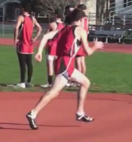
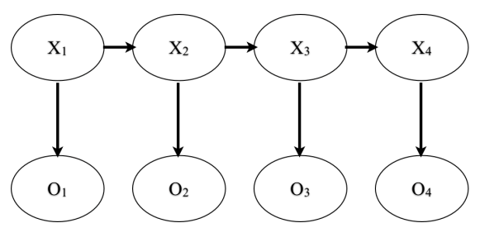
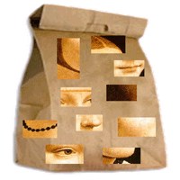
Activity landscape
Activities
Events
Long term event
Snapshot
Atomic action
10⁻¹
10⁰
10¹
10³
10⁷⁻⁸
Temporal Scale (seconds)
Possible approaches:
Pose-based recognition
HMM, CRF
Bag of features
  Computationally intensive
  Simple action recognition: Fails when actions are complex
Ferrari et al 2008
Ramanan & Forsyth 2003
Nazli & Forsyth 2008
[…]
Laptev et al 2008
Niebles et al 2006
Liu et al 2009
Sminchisescu 2006
Blank et al 2005
Efros et al 2003 […]

Slide 8
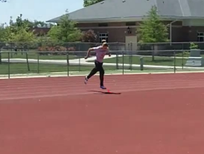
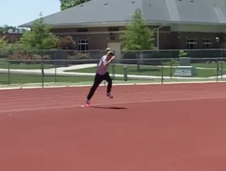
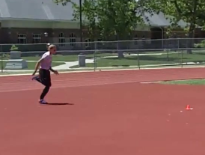
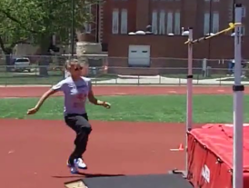
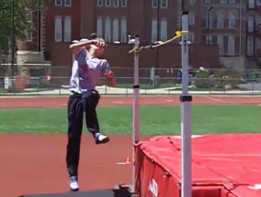
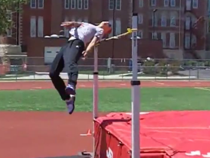
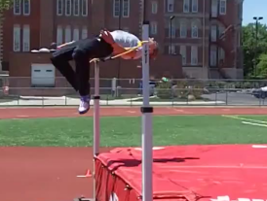
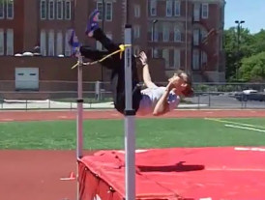
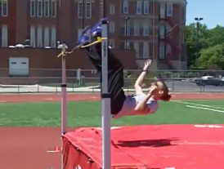
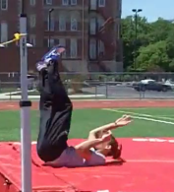
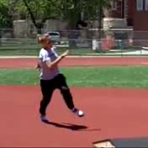
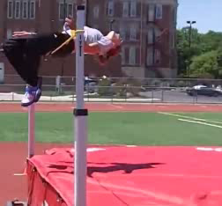
Our proposal – decompose activities into simpler motion segments
Simple motions are easier to describe computationally
Can leverage temporal context
Human visual system seems to rely on decomposition for understanding [Zacks et al, Nature Neuro 2001, Tversky et al, JEP, 2006]

Slide 9
Outline
Discriminative model for activities
  Representation
  Recognition
  Learning
Experiments
Conclusions

Slide 10
Outline
Discriminative model for activities
  Representation
  Recognition
  Learning
Experiments
Conclusions

Slide 11
A model for activities
Activity Model

Slide 12
A model for complex activities
Activity Model
Model Properties
0
1
Use a standard time range: [0,1]
[
]
time

Slide 13
A model for complex activities
Activity Model
Model Properties
0
1
Use a standard time range: [0,1]
Model is formed by a few simple motions
[
]
time

Slide 14
A model for complex activities
Activity Model
Model Properties
0
1
Use a standard time range: [0,1]
Model is formed by a few simple motions
[
]
time

Slide 15



A model for complex activities
Activity Model
Model Properties
0
1
Use a standard time range: [0,1]
Model is formed by a few simple motions
Local motion appearance
[
]
time
: Motion Segment 1

Slide 16
A model for complex activities
Activity Model
Model Properties
0
1
Use a standard time range: [0,1]
Model is formed by a few simple motions
Local motion appearance
Encode temporal order
[
]
: anchor location
time
: Motion Segment 1

Slide 17
A model for complex activities
temporal location uncertainty
Activity Model
Model Properties
0
1
Use a standard time range: [0,1]
Model is formed by a few simple motions
Local motion appearance
Encode temporal order
Temporal flexibility
[
]
: anchor location
time
: Motion Segment 1

Slide 18
A model for complex activities
temporal location uncertainty
Activity Model
Model Properties
0
1
Use a standard time range: [0,1]
Model is formed by a few simple motions
Local motion appearance
Encode temporal order
Temporal flexibility
Multiple temporal scales
[
]
: anchor location
time
shorter
: Motion Segment 1
longer

Slide 19
Outline
Discriminative model for activities
  Representation
  Recognition
  Learning
Experiments
Conclusions

Slide 20
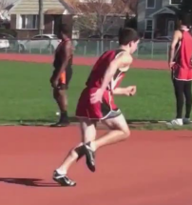
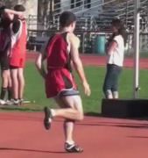
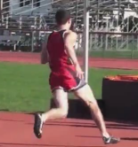
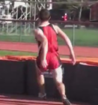
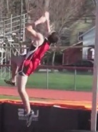
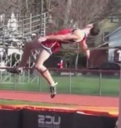
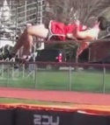
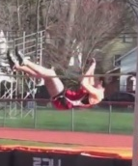
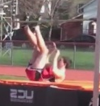
Recognition
Query Video

Slide 21
Recognition
Query Video
0
1
[
]
Activity Model
0
1
[
]

Slide 22
Recognition
Query Video
0
1
[
]
Match Motion Segment 1:
Activity Model
0
1
[
]

Slide 23
Recognition
Query Video
0
1
[
]
Match Motion Segment 1:
Consider a candidate location
Activity Model
0
1
[
]

Slide 24
Recognition
Query Video
0
1
[
]
Match Motion Segment 1:
Consider a candidate location
Matching score for this segment:
Activity Model
0
1
[
]

Slide 25
Recognition
Query Video
0
1
[
]
Match Motion Segment 1:
Consider a candidate location
Matching score for this segment:
Activity Model
0
1
[
]

Slide 26
Recognition
Query Video
0
1
[
]
Match Motion Segment 1:
Consider a candidate location
Matching score for this segment:
Spatio-temporal Interest points
HOG/HOF Descriptors
[Laptev et al, 2005]
Activity Model
0
1
[
]

Slide 27
Recognition
Query Video
0
1
[
]
Match Motion Segment 1:
Consider a candidate location
Matching score for this segment:
Vector-quantized into a codebook of 1000 spatio-temporal words.
Activity Model
0
1
[
]

Slide 28


Recognition
Query Video
Video words
0
1
[
]
Match Motion Segment 1:
Consider a candidate location
Matching score for this segment:
Appearance feature:
histogram of video words
Activity Model
0
1
[
]

Slide 29
Recognition
Query Video
Video words
0
1
[
]
Match Motion Segment 1:
Consider a candidate location
Matching score for this segment:
Appearance similarity score:
Chi-square kernel SVM
Activity Model
0
1
[
]

Slide 30
Recognition
Query Video
0
1
[
]
Match Motion Segment 1:
Consider a candidate location
Matching score for this segment:
Activity Model
0
1
[
]

Slide 31
Recognition
Query Video
0
1
[
]
Match Motion Segment 1:
Consider a candidate location
Matching score for this segment:
Activity Model
0
1
[
]

Slide 32
Recognition
Query Video
0
1
[
]
Match Motion Segment 1:
Consider a candidate location
Matching score for this segment:
Temporal location feature:
the distance btw h_1 and the anchor location:
Activity Model
0
1
[
]

Slide 33

Recognition
Query Video
0
1
[
]
Match Motion Segment 1:
Consider a candidate location
Matching score for this segment:
Temporal location disagreement score: 2nd order polynomial
Activity Model
0
1
[
]

Slide 34
Recognition
Query Video
0
1
[
]
Match Motion Segment 1:
Consider a candidate location
Matching score for this segment:
Activity Model
0
1
[
]

Slide 35
Recognition
Query Video
0
1
[
]
Match Motion Segment 1:
Consider a candidate location
Matching score for this segment:
Activity Model
0
1
[
]

Slide 36
Recognition
Query Video
0
1
[
]
Match Motion Segment 1:
Consider a candidate location
Matching score for this segment:
Activity Model
0
1
[
]

Slide 37
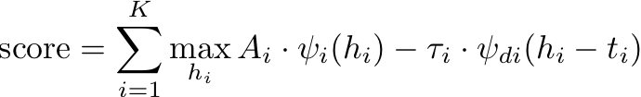

Recognition
Query Video
0
1
[
]
Matching score for all segments:
Activity Model
0
1
[
]

Slide 38
Outline
Discriminative model for activities
  Representation
  Recognition
  Learning
Experiments
Conclusions

Slide 39





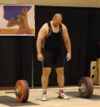
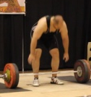
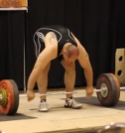
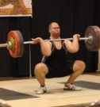
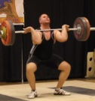
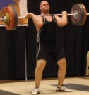
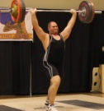
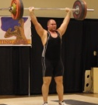
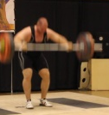
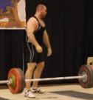








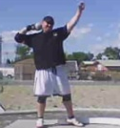
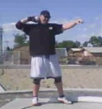




























Learning from weakly labeled data
positive examples
negative examples
39
YouTube videos
Class label per video collected on Amazon Mechanical Turk
No annotation of temporal segments
39

Slide 40










Learning from weakly labeled data
positive examples
negative examples
40
Activity Model
0
1
[
]
40

Slide 41



Learning
Goal
Learn:
Motion segment appearance
Temporal arrangement
A max-margin framwork by optimizing a discriminative loss:
➔ Coordinate descend
[Felzenszwalb et al 2008]
Activity Model
0
1
[
]
41

Slide 42















Learning
Coordinate descend
Initialize model parameters
positive examples
negative examples
Activity Model
[
1
]
0

Slide 43
Learning
Coordinate descend
Initialize model parameters
Find best matching locations
positive examples
negative examples
Activity Model
[
1
]
0

Slide 44
Learning
Coordinate descend
Initialize model parameters
Find best matching locations
Update
positive examples
negative examples
Activity Model
[
1
]
0

Slide 45
Learning
Coordinate descend
Initialize model parameters
Find best matching locations
Update
positive examples
negative examples
Activity Model
[
1
]
0

Slide 46
Learning
Coordinate descend
Initialize model parameters
Find best matching locations
Update
Repeat till convergence (or max iter.)
positive examples
negative examples
Activity Model
[
1
]
0

Slide 47
Outline
Discriminative model for activities
  Representation
  Recognition
  Learning
Experiments
Conclusions

Slide 48

Experiment I: Simple Actions
KTH dataset [Schuldt et al 2004]
Action Class | Our Model
walking | 94.4%
running | 79.5%
jogging | 78.2%
hand-waving | 99.9%
hand-clapping | 96.5%
boxing | 99.2%
walking
jogging
running
boxing
hand-waving
hand-clapping

Slide 49





Experiment II: Proof of concept
Activities synthesized from Weizmann [Blank 2005]
6 classes
  Ours 100%
  Bag-of-Features 17%
Ours | 100%
Bag-of-features | 17%
wave
jump
jumping - jacks
Activity Model
0
1
[
]
shorter
jumping jacks
waving
waving
Transition from jump to jumping jacks
jumping jacks
longer

Slide 50





Experiment III: Olympic Sports Dataset
YouTube videos with class labels per video from AMT
16 classes, ~100 videos each
http://vision.stanford.edu/Datasets/OlympicSports
high-jump
long-jump
triple-jump
pole-vault
discus
hammer
javelin
shot put
basketball
lay-up
bowling
tennis-serve
platform
springboard
snatch
clean-jerk
vault

Slide 51





Learned model: High Jump
Activity Model
0
1
[
]
shorter
Landing & stand up
Start running
Run
Take off
longer
Run

Slide 52
Learned model: High Jump
Activity Model
0
1
[
]
shorter
Landing & stand up
Start running
Run
Take off
longer
Run
Shorter segment, larger location uncertainty

Slide 53
Learned model: High Jump
Activity Model
0
1
[
]
Landing & stand up
Start running
Run
Take off
Run
Long segment, small location uncertainty

Slide 54





Learned Model: Clean and Jerk
Activity Model
0
1
[
]
Hold weight while crouching
Lift Weight to shoulders
Hold weight on shoulders
Hold weight while crouching
Transition to upright position

Slide 55
Learned Model: Clean and Jerk
Activity Model
0
1
[
]
Hold weight while crouching
Lift Weight to shoulders
Hold weight on shoulders
Hold weight while crouching
Transition to upright position
Short segment with low location uncertainty, it had high location consistency in training

Slide 56
Learned Model: Clean and Jerk
Activity Model
0
1
[
]
Hold weight while crouching
Lift Weight to shoulders
Hold weight on shoulders
Hold weight while crouching
Transition to upright position
Segments encode
similar appearance,
possible locations overlap

Slide 57
Matched Sequences
Long Jump
Sequence 1
Run
Take off
Stand up
Long Jump Sequence 2
Remarks:
Matching is tolerant to variations in exact motion segment temporal location.
Query videos can have different time length.
Long Jump Model
0
1
[
]

Slide 58
Matched Sequences
Vault Sequence 1
Run
Up in the air
Landing
Vault
Sequence 2
Low matching score, good temporal alignment, bad appearance.
Vault Model
0
1
[
]

Slide 59
Classifying Olympic Sports
Our Method | 72.1%
Laptev et al 2008 | 62.0%

Slide 60
Outline
Discriminative model for activities
  Representation
  Recognition
  Learning
Experiments
Conclusions

Slide 61
Conclusions
Temporal context and structures are useful
for activity recognition
Olympic Sports Dataset
(16 classes, ~100 video/class)
Future directions
Explore richer temporal structures;
Introduce semantics for more meaningful decomposition

Slide 62




Bangpeng Yao, Barry Chai, Jia Deng, Hao Su, Olga Russakovsky, and all Stanford Vision Lab members.
Thank you!
Juan Carlos Niebles
Graduate student
Princeton/Stanford

Slide 63
Matched Sequences
Snatch
Sequence
Lift weight above head
Transition to upright position
Hold weight above head
Clean-Jerk
Sequence
Similar appearance, low location matching.
Snatch Model
0
1
[
]

